Slide 1




Chandil Polytechnic, Chandil
(Established By Govt. Of Jharkhand And Run By
Gurunanak Polytechnic Foundation Under PPP Mode)
WELCOME!
Welcome to Cpc
NEW BATCH 2019-22

Slide 2


Chandil Polytechnic, Chandil
November 29, 2019
5

Slide 3
Welcome
Approved by AICTE and Affiliated to JUT
6

Slide 4
Status
Chandil Polytechnic is a Diploma College Established by Government of Jharkhand and Run by Gurunanak Polytechnic Foundation (GPF hereafter) under PPP
College got started in 2017
GPF is an unit of JIS Group , the largest Educational Conglomerate of Eastern India, having 25 institution involved in providing quality education to young India.
7

Slide 5
JIS …
Group with over 25000 students, received Best Educational Brand Award 2017 by Economic Times, has highly experienced teachers and strong placement assistance
Institutions with remarkably good computer lab, workshop and library have ‘A’ Grade NAAC accreditation
8

Slide 6

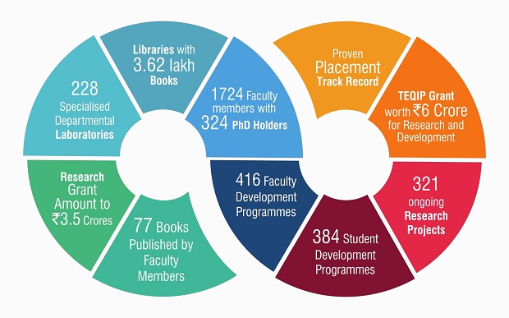
JIS …
8

Slide 7
JIS …
Many More…………….
8

Slide 8
Chandil Polytechnic: Infrastructure
The infrastructure and buildings are by GoJ
Location: 100 km away(south east from Ranchi), 8 km from Chandil Rly Stn and 7 km from Chandil market.
Land area: 6.986 Acres
Administrative and Academic block: 8610 sq.mts
it is a 3/4 storey building
9

Slide 9
Infrastructure….…..
Boys Hostel: 3956 sq. mts – four story building 100 rooms - 3 bedded
Faculty quarter: 834 sq. mts four storey building- eight accommodations – two BHK flats
Bachelor’s staff quarter 646: sq. mts -16 accommodations – four storey building- one BHK flat
Workshop 487: sq. mts – Old Irrigation department shed- converted
10

Slide 10
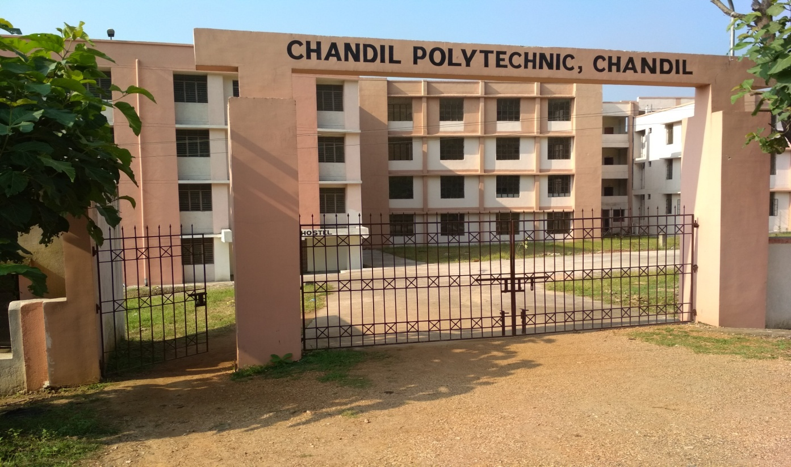
Buildings
9

Slide 11
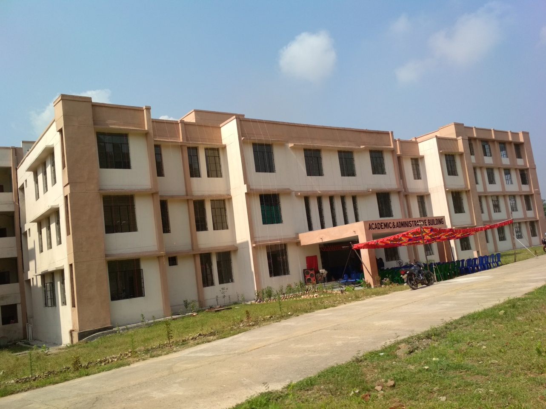
Buildings …….(Academic Building)
)
9

Slide 12
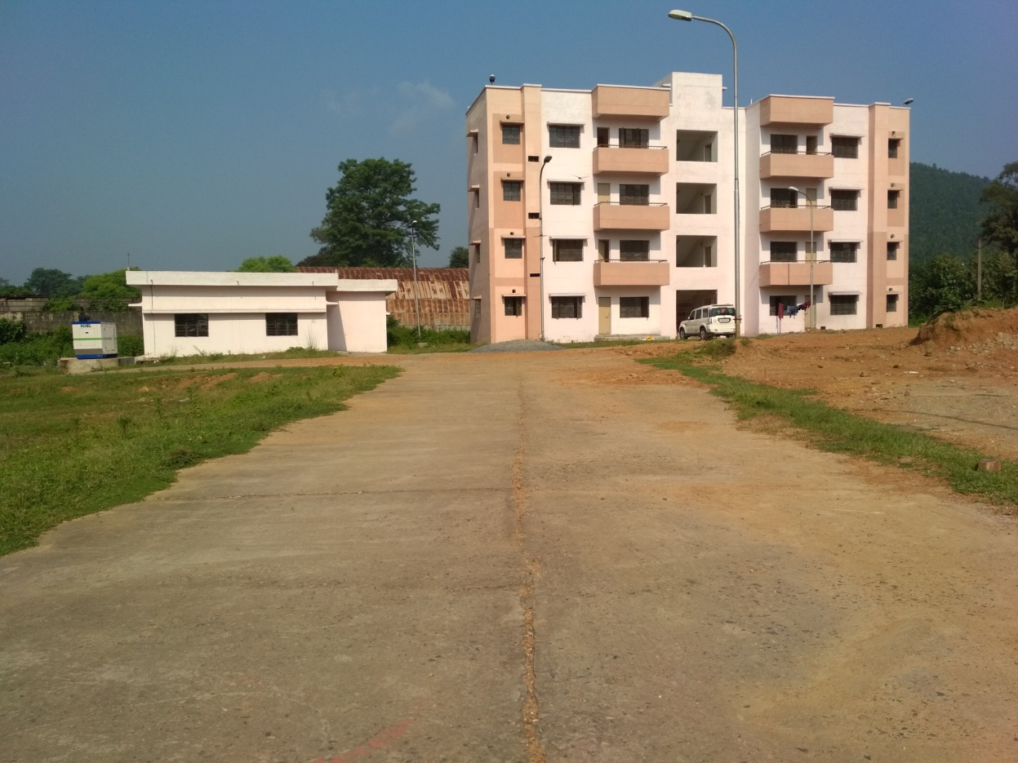
Buildings …….(Faculty quarter)
9

Slide 13
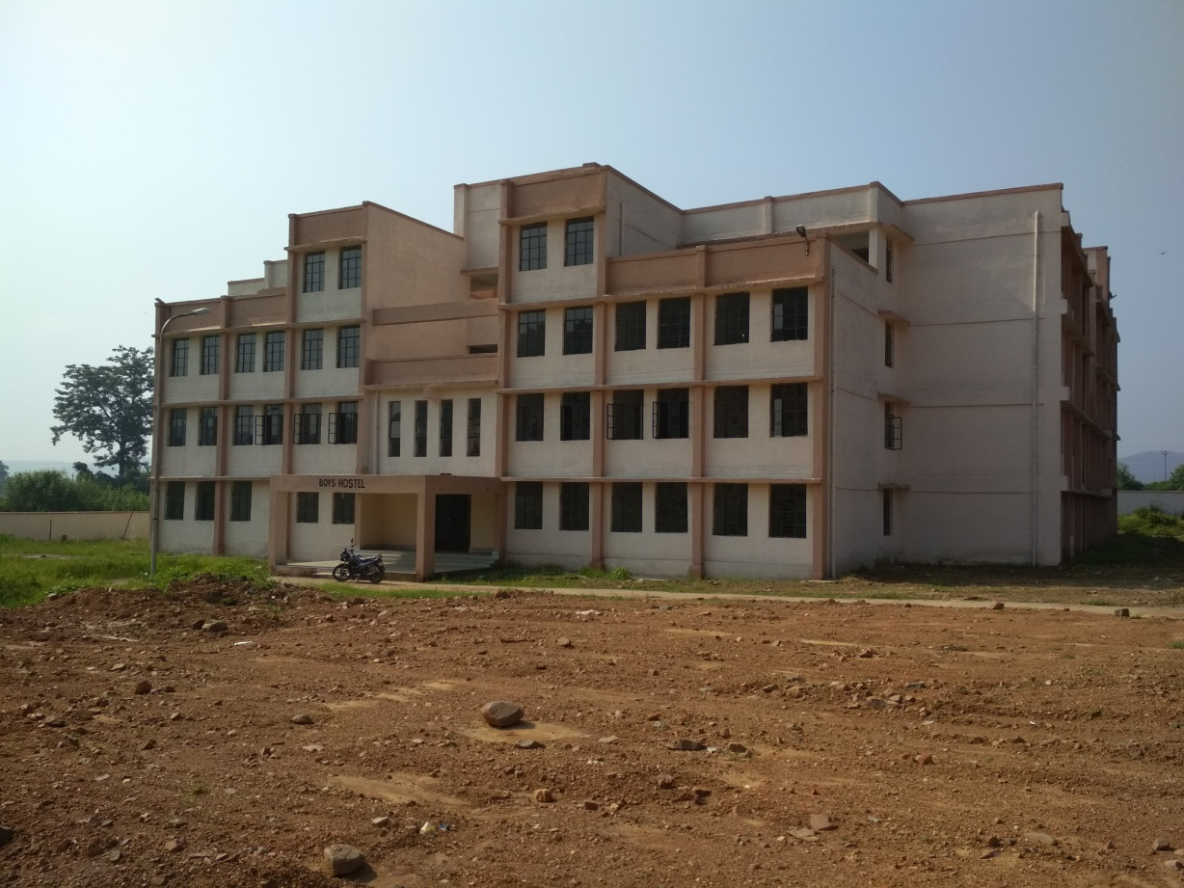
Buildings …….(Boys Hostel)
9

Slide 14
Intake
Sanctioned seat : 300
Branches : 5
Civil Engineering
Electrical Engineering
Electrical and Electronics
Mechanical
Mechanical Engineering - Automobile
Each having 60 seats
11

Slide 15
Laboratory
1st Year
Physics Lab.
Chemistry Lab.
Computer Lab.
Workshop
Language Lab.
Drawing Lab.
12

Slide 16
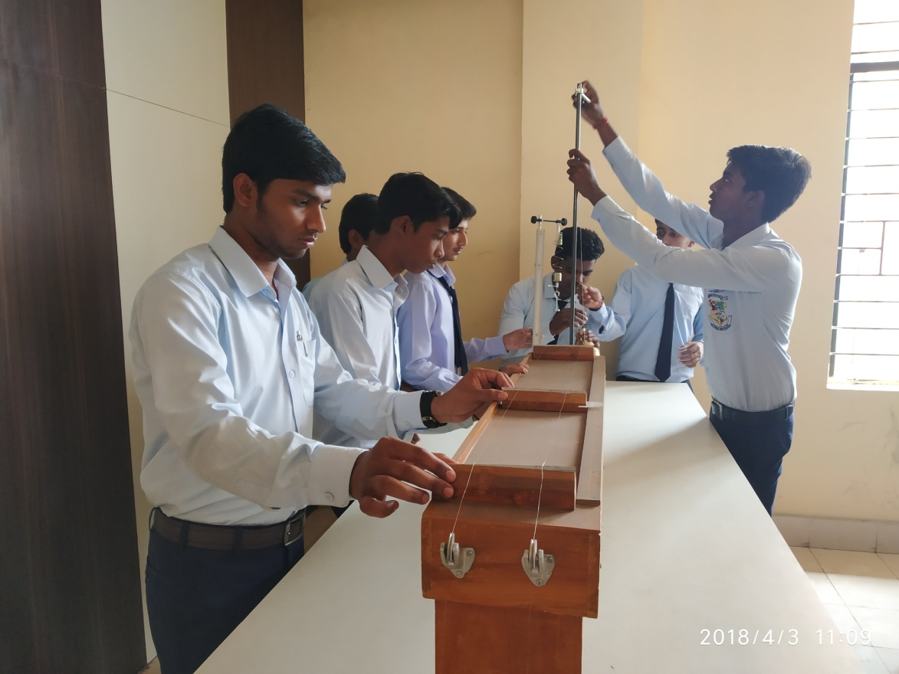
Laboratory
12

Slide 17
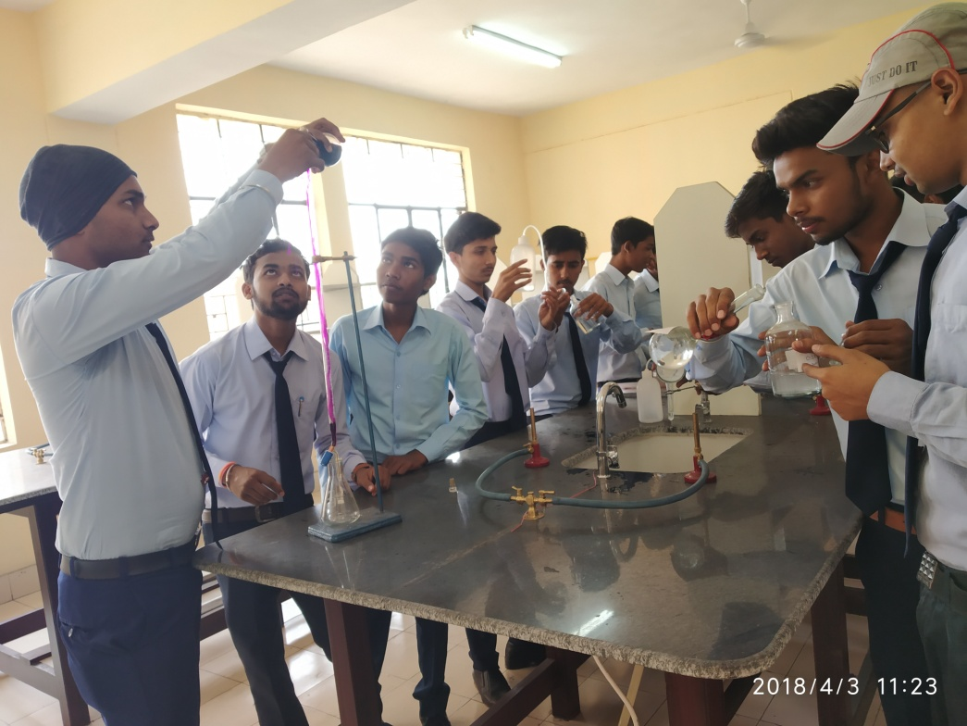
Laboratory
13

Slide 18
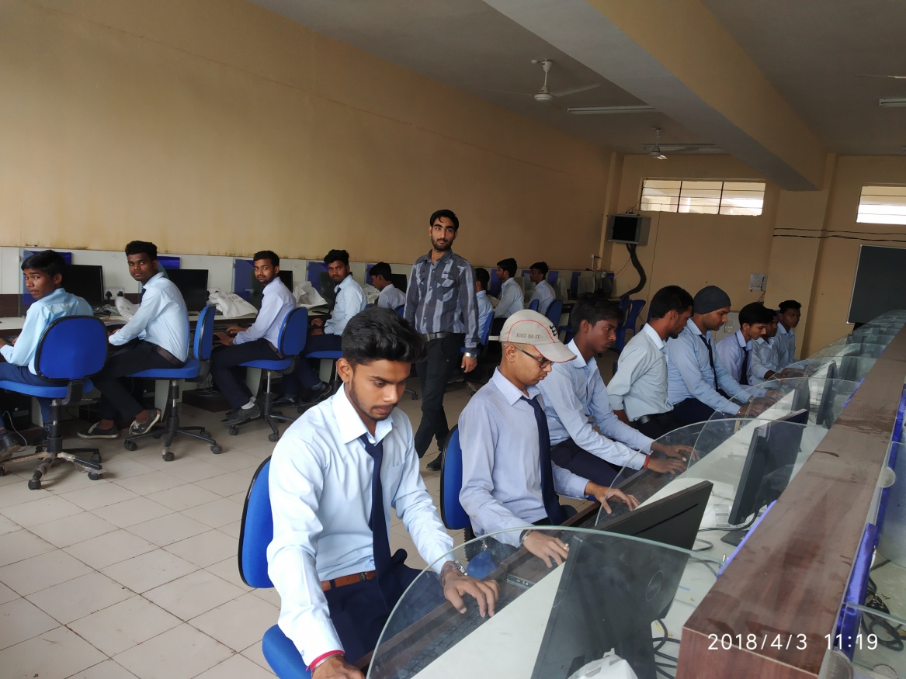
Laboratory
15

Slide 19
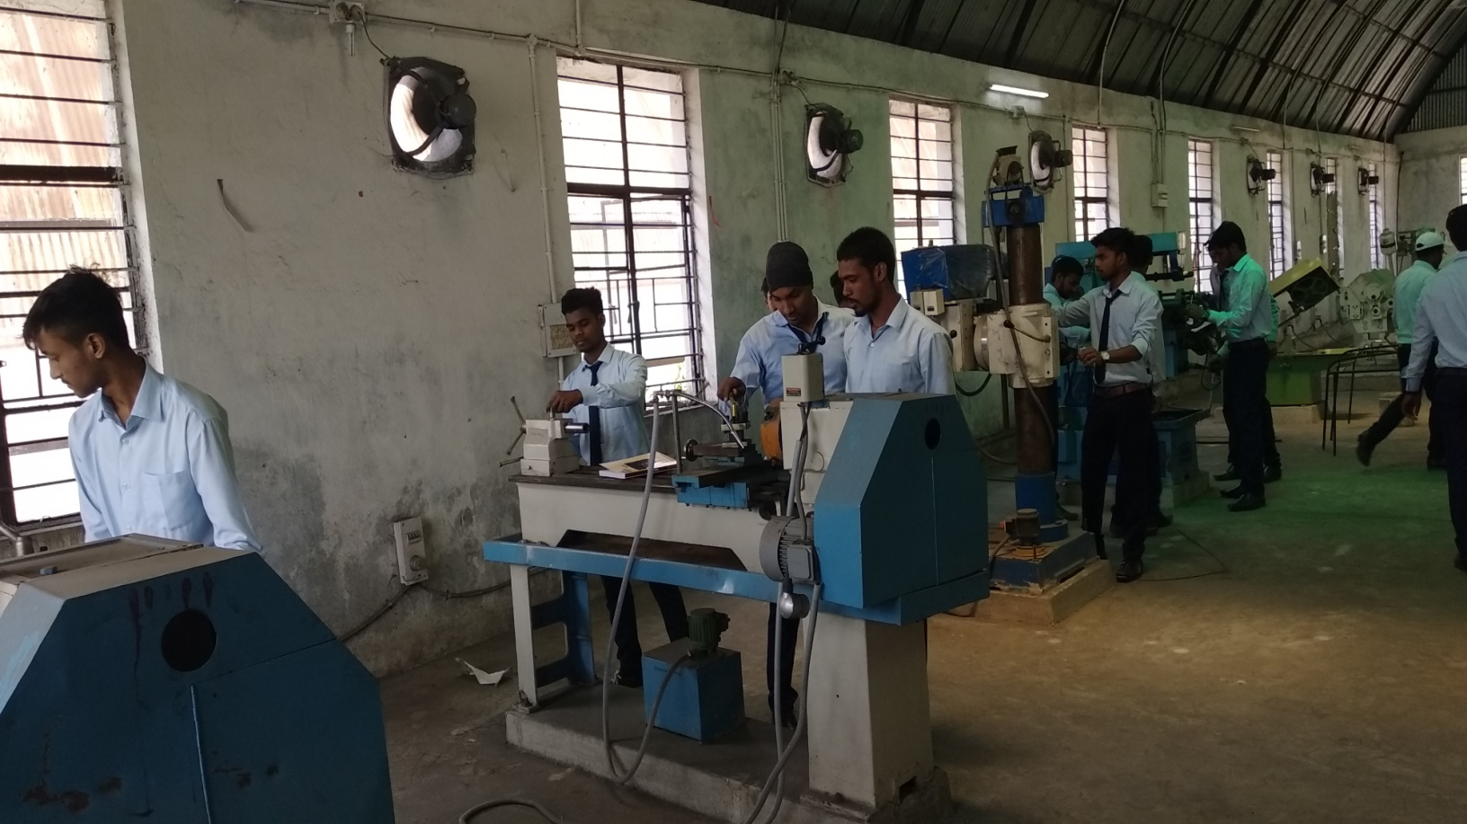
14

Slide 20
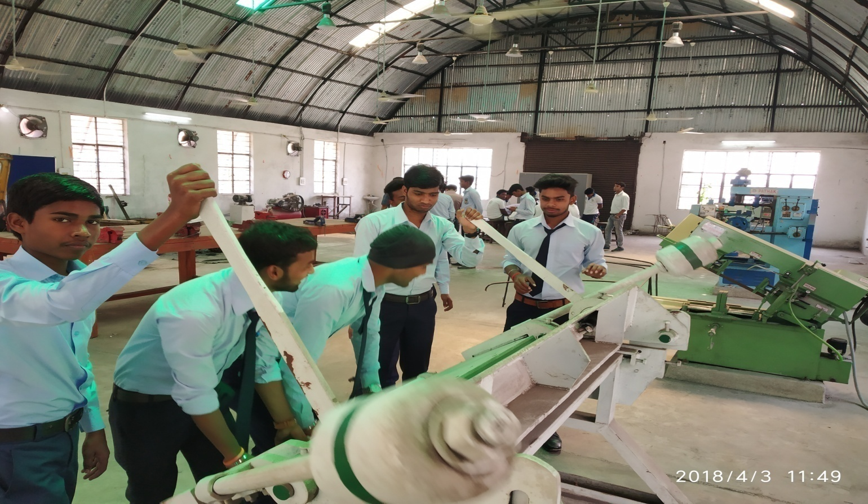
15

Slide 21
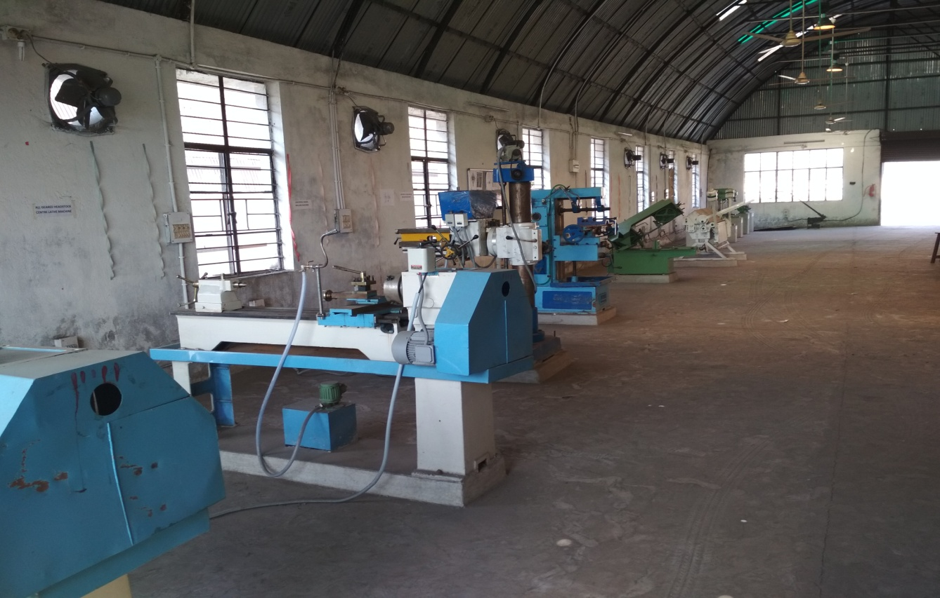
15

Slide 22
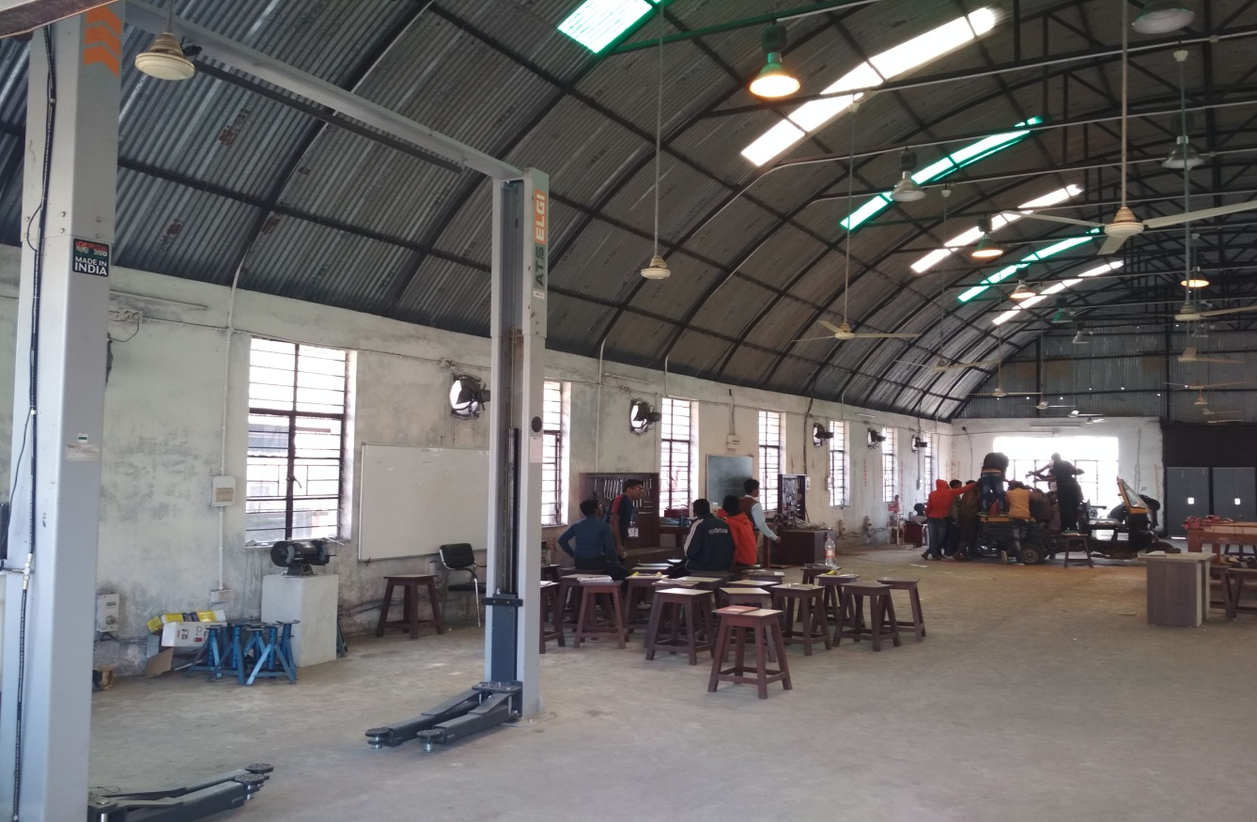
16

Slide 23
Departmental Laboratory
1.Mechanical Labs.
2.Civil Labs.
3.Electrical Labs.
4.EEE Labs.
5.ME-Auto Labs.
16

Slide 24
Academic Activities
Two separate committees
Examination committee
Academic Committee
Work with defined responsibilities
17

Slide 25
Academic… cont..
Two internal tests
Internal Viva
75% attendance
18

Slide 26
Introduction to 1st semester
Subjects
Communication Skill – I
Engineering Math – I
Engineering Physics - I
19

Slide 27
Engineering Chemistry – I
Engineering Graphics – I Th
Fundamental of Computer
Workshop - I
19

Slide 28
Other Activities
Sports Committee : Takes care of sports activities
Hostel and Mess committee: looks after the hostel maintenance and the quality of food being served.
20

Slide 29
Cultural committee: Takes care of cultural activities
Other Committees.
22

Slide 30
College Rules
Campus Rules
Hostel Rules
Mess Rules
Library Rules
Examination rules
23

Slide 31
CPC is Ragging Free
Anti Ragging Committee
Anti Ragging Squad
24

Slide 32
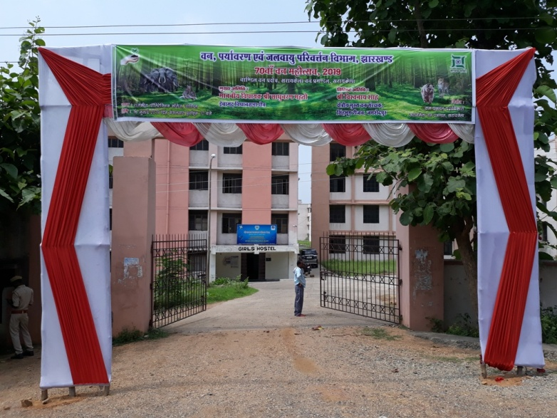
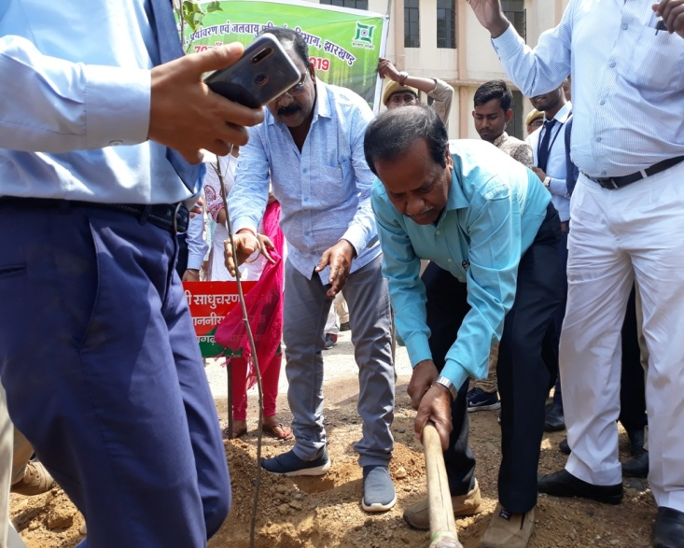
Other Activities
23

Slide 33
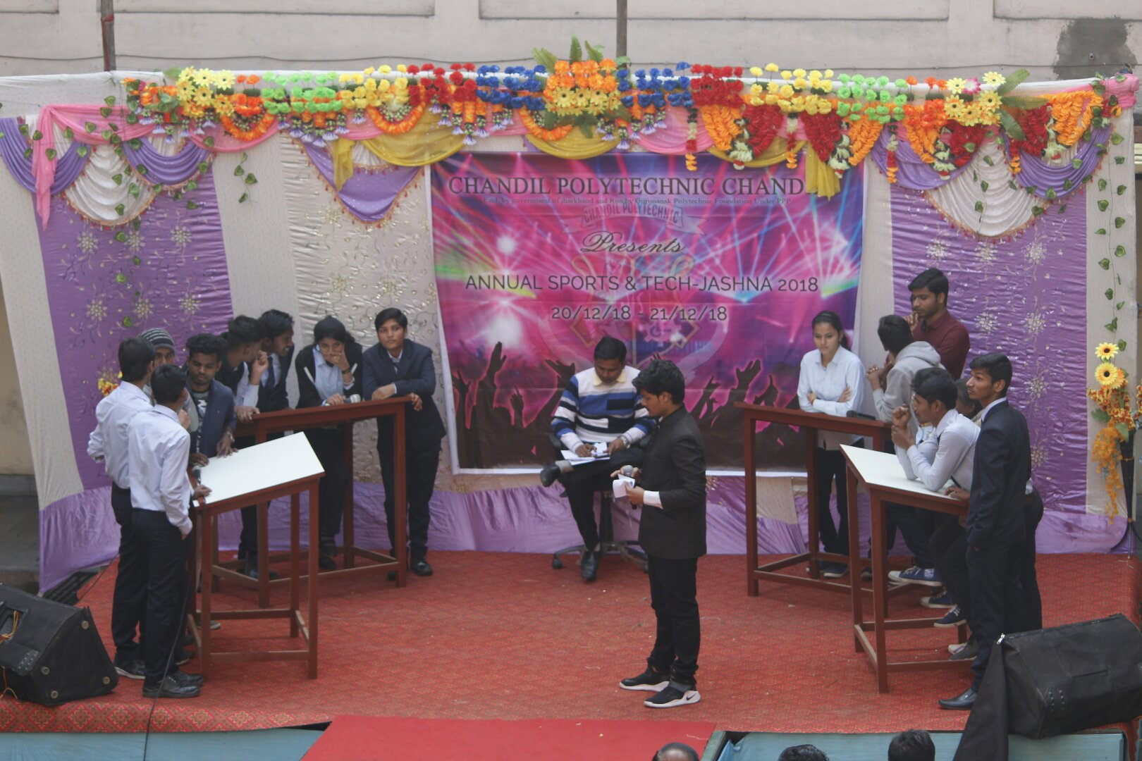
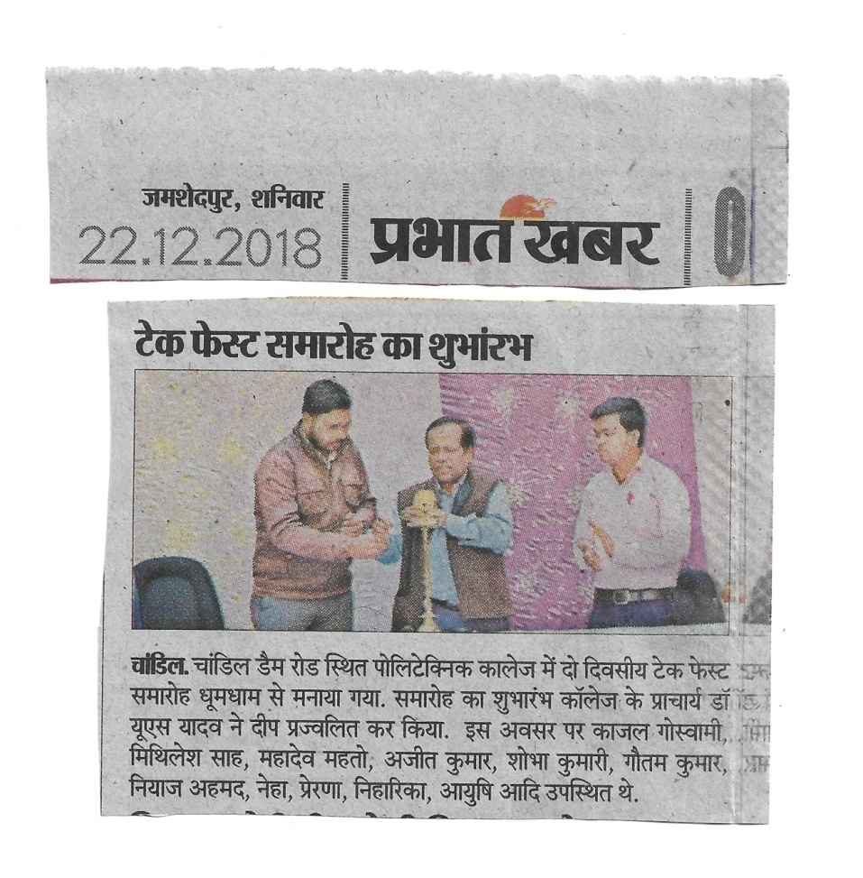
25

Slide 34
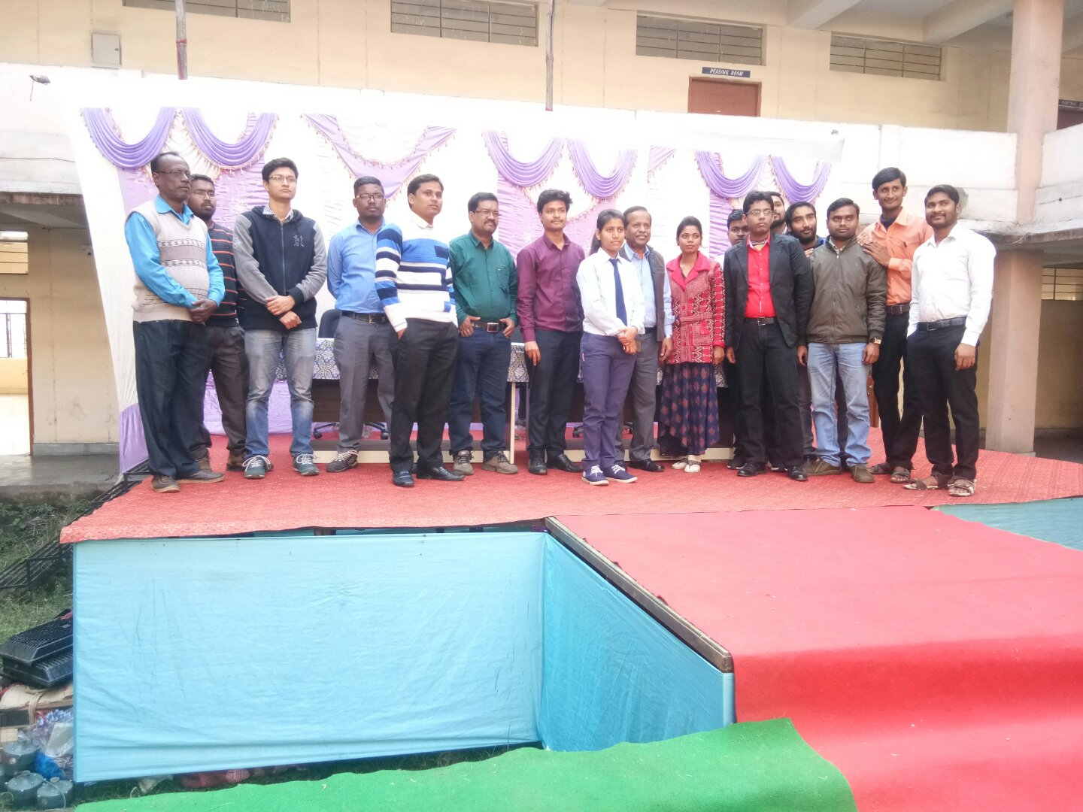
26

Slide 35
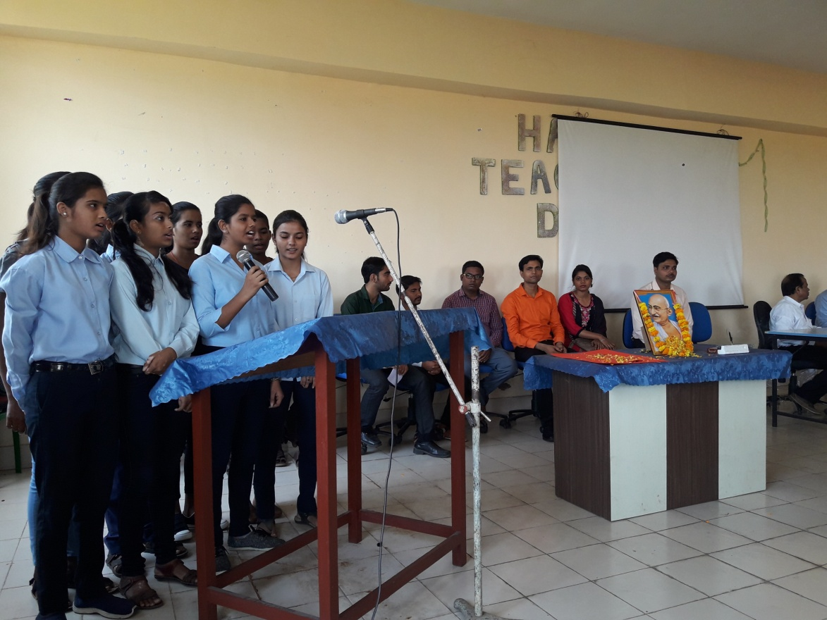
26

Slide 36
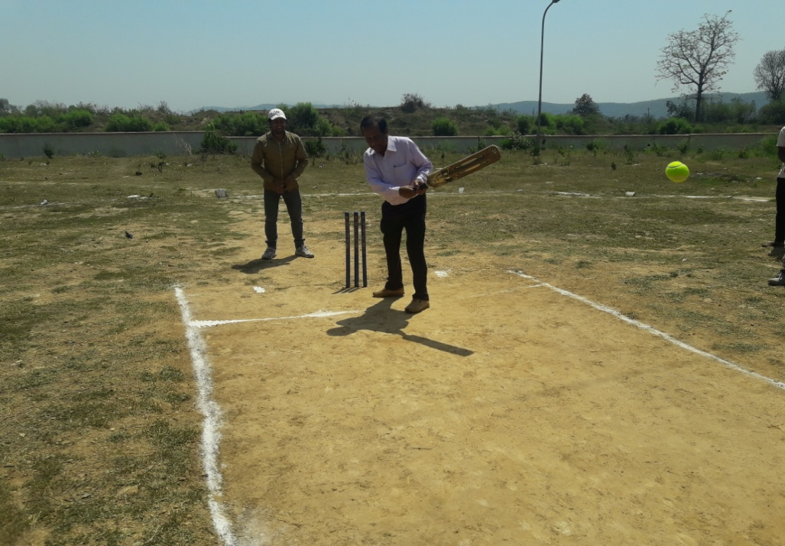
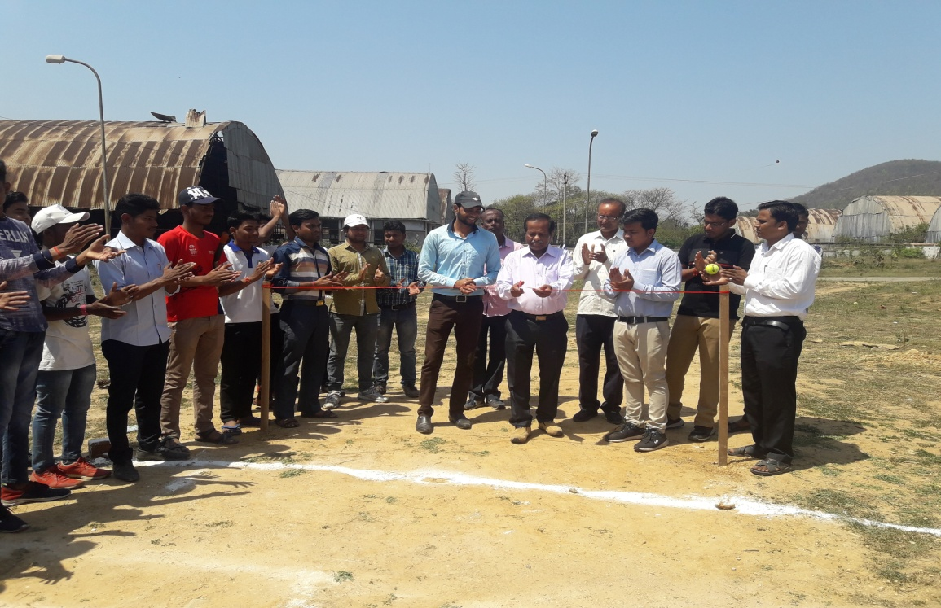
26

Slide 37
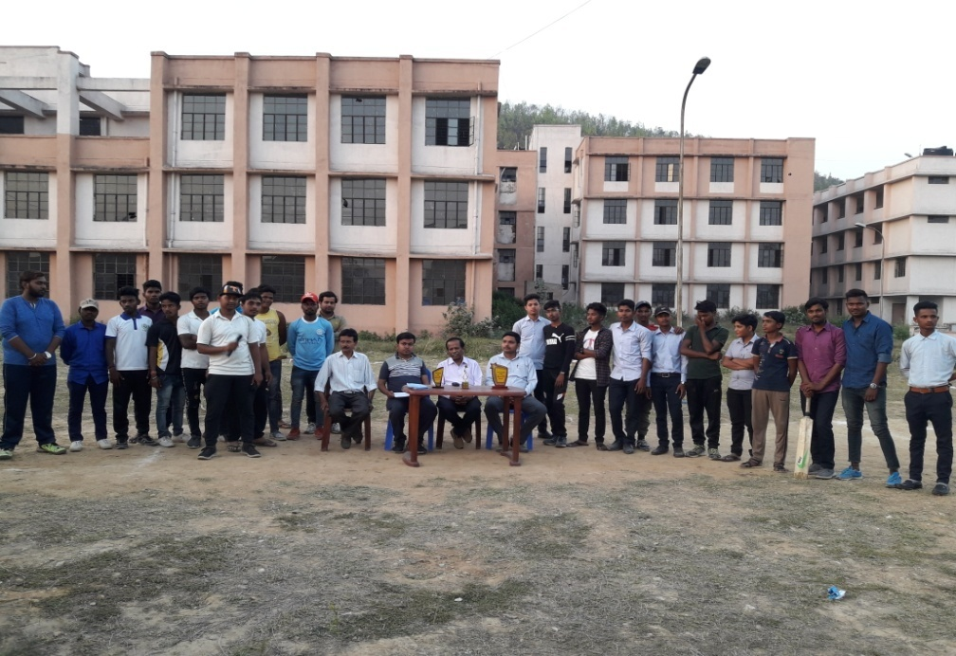
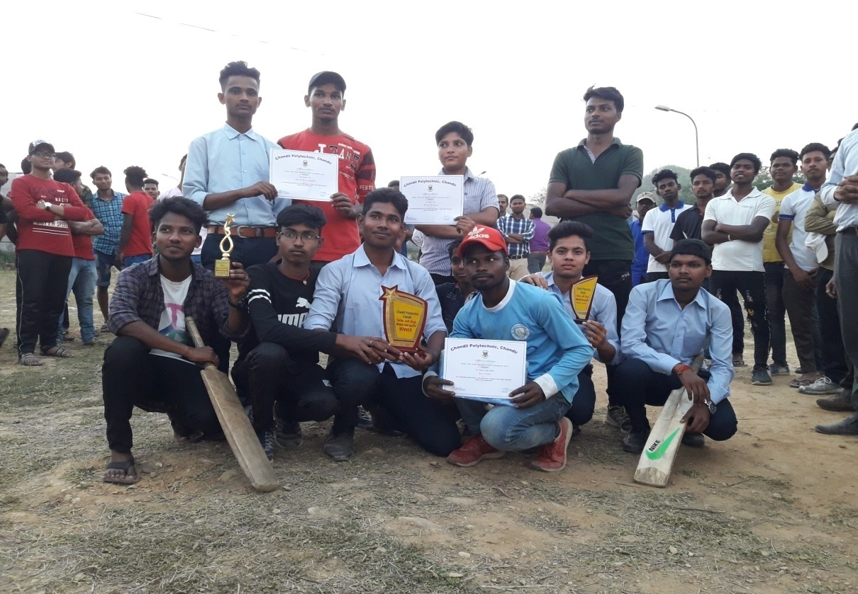
26

Slide 38
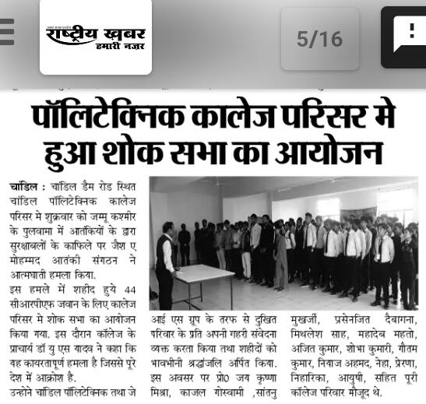
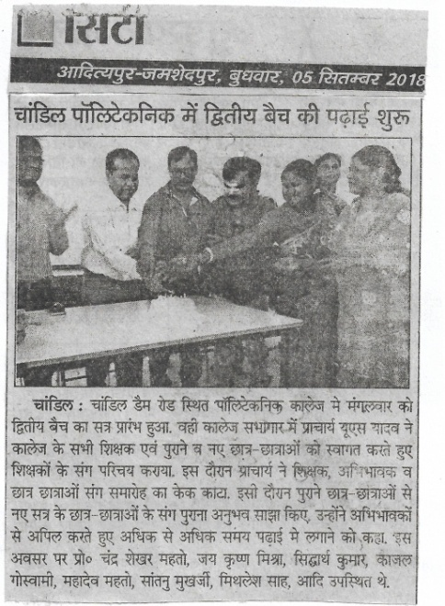
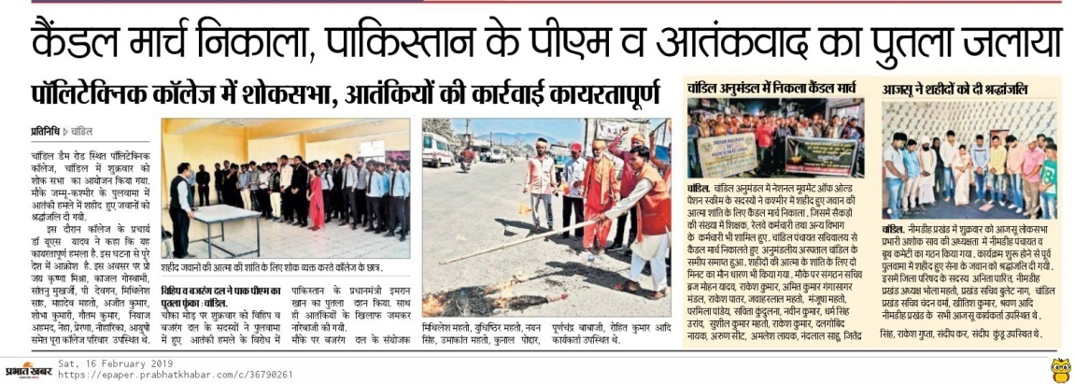
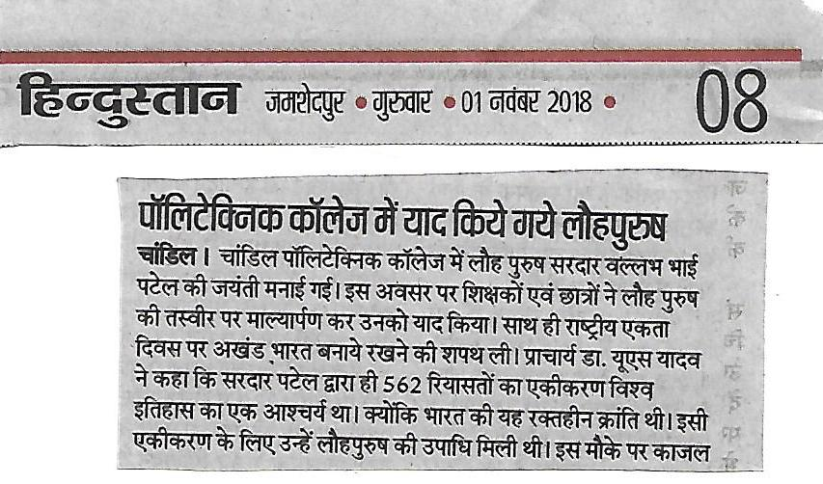
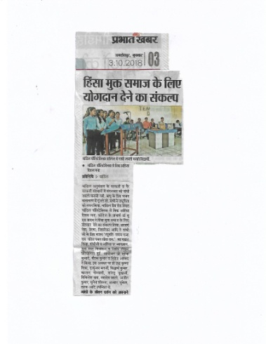
26

Slide 39
Conclusions
Chandil Polytechnic is a Diploma College Estd. by GoJ and Run by GPF(JIS Group) under PPP
The college has five branches with 60 sanctioned seats in each branch.
The operation started in 2017 with 149 students
27

Slide 40
Conclusions—contd…
Two hostels one for Boys and another for Girls on the campus.
Sports facilities (Badminton, Cricket, Football, Volleyball) are available on campus
28

Slide 41
Conclusions—contd…
Committees with defined responsibilities are working for smooth working.
29

Slide 42
Thank You!

