Slide 1


Chandil Polytechnic Chandil
Welcome to
Chandil Polytechnic, Chandil

Slide 2
Chandil Polytechnic Chandil
Basic Science and Humanities
Communication Skill
Engineering Physics
Engineering Chemistry
Engineering Mathematics
Fundamental of Computer
Programming in C.
7

Slide 3
Laboratory
1st Year
Physics Lab.
Chemistry Lab.
Computer Lab.
Workshop
Language Lab.
Drawing Lab.
12

Slide 4
Chandil Polytechnic Chandil
What is Physics????
Physics is the branch of science
which deals with the nature and natural phenomenon.
8

Slide 5
Chandil Polytechnic Chandil
Branches of physics
Generally 11 branches of physics. These are as follows
Classical Physics 6. Biophysics
Modern Physics 7.Mechanics
Nuclear Physics 8.Optics
Atomic Physics 9. Acoustics
Geophysics 10. Thermodynamics and 11. Astrophysics
8

Slide 6
b contents
Topics to be covered:
Gravitation
Force and Motion
Sound
Elasticity
Surface tension
Viscocity etc
8

Slide 7
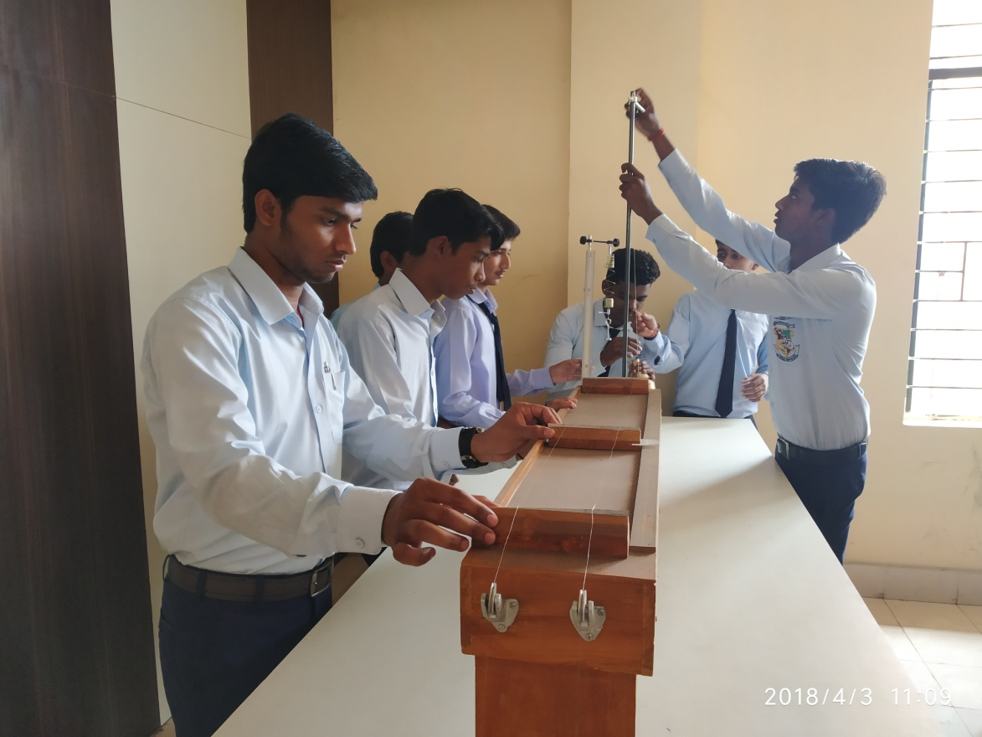
Laboratory
12

Slide 8
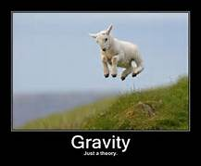

Gravity
Chandil Polytechnic Chandil
It is the force of attraction between the earth and any other object which is lies on the earth or near the surface of the earth.

Slide 9
Newton’s law of gravitation
Every object attracts every other objects with a force. According to this law , “ the
force of attraction between two point object is directly proportional to product of their masses and inversely proportional to the square of the distance between them.”
This force is act along the line joining
between the centre of the two bodies.

Slide 10
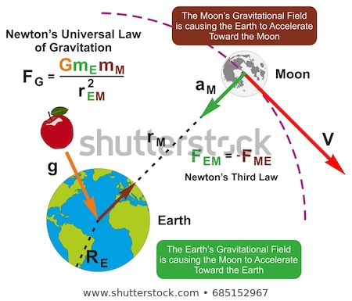
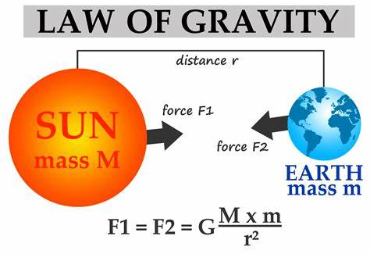
Chandil Polytechnic Chandil

Slide 11
Acceleration Due to Gravity
Chandil Polytechnic Chandil
Acceleration produce in freely falling body towards the centre of the earth is called acceleration due gravity. It is denoted by the alphabet “g”. It’s value is approximately 9.8 m/square second (In S.I. system of unit)

Slide 12
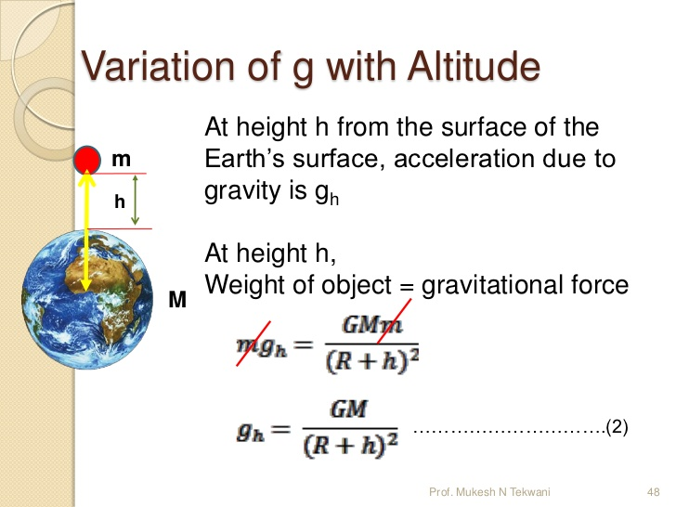
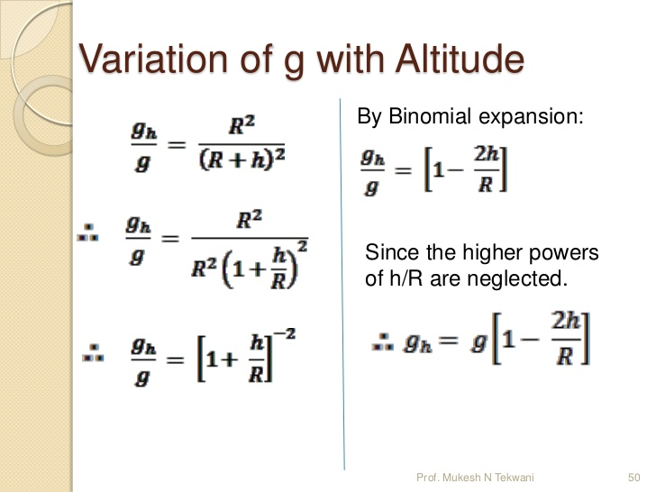
Variation of “g” with Altitude
Chandil Polytechnic Chandil

Slide 13
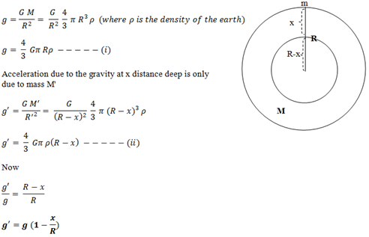
Variation of “g” with Depth

Slide 14
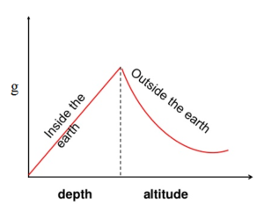
Variation in “g” with Altitude & Depth
Chandil Polytechnic Chandil

Slide 15
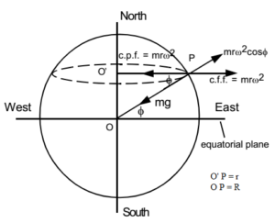
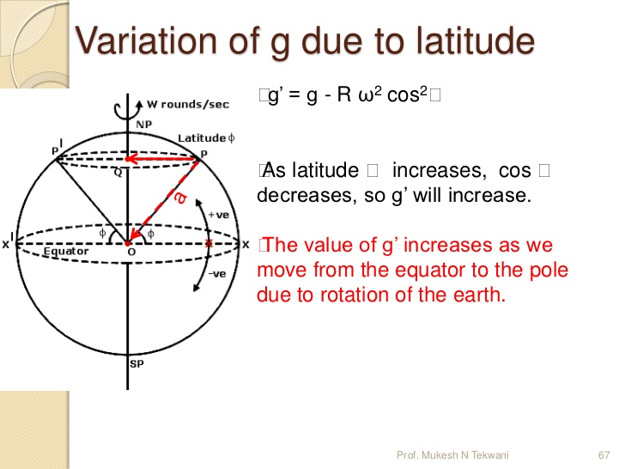
Variation with Latitude
Chandil Polytechnic Chandil

Slide 16
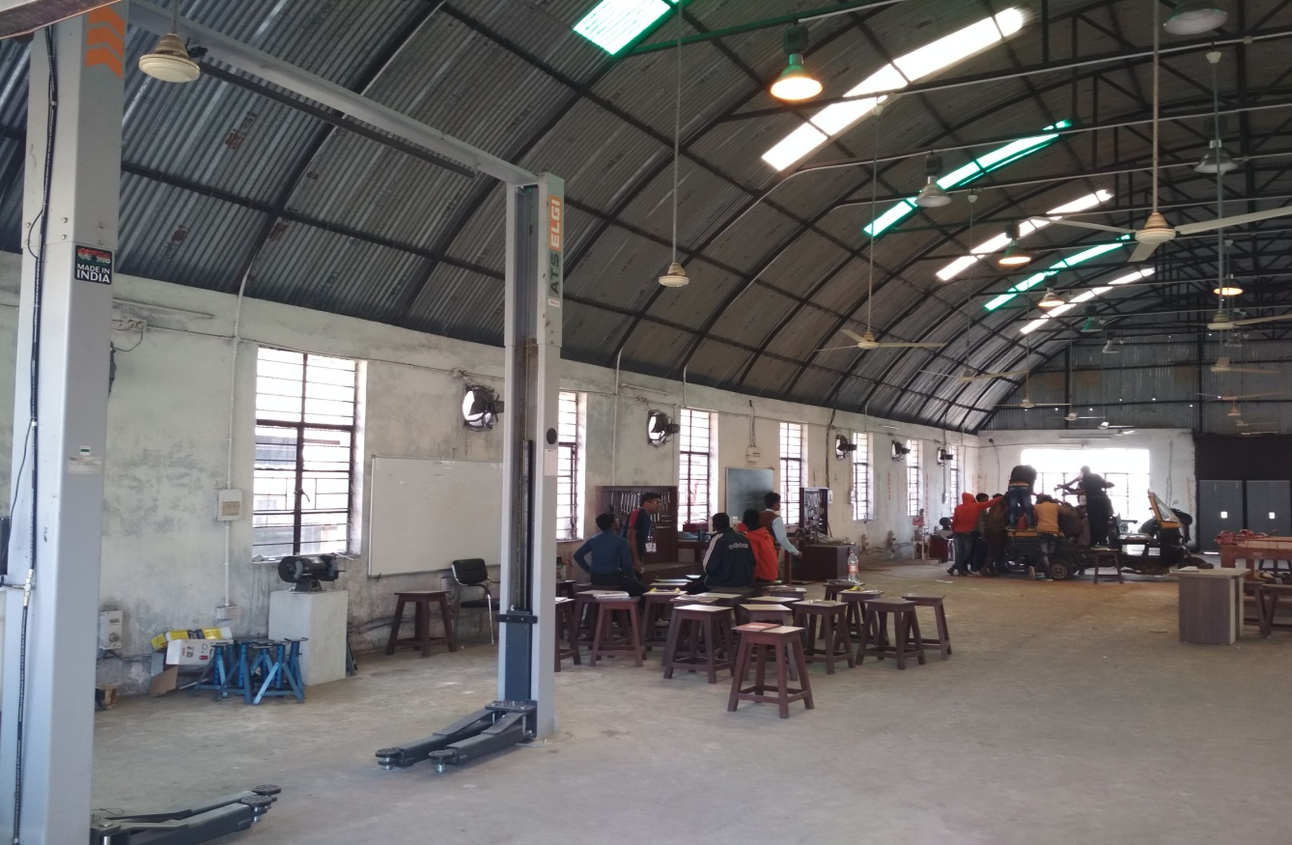
Chandil Polytechnic Chandil
16

Slide 17
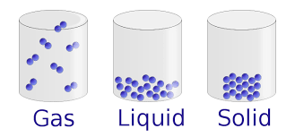
Engineering Chemistry
Chemistry is the branch of science which deals with
constituents, properties, application etc of the matter.
8

Slide 18
Engineering Chemistry
Atomic Structure
Metals and Alloys
Non metallic Engineering materials
Environmental Affects.
Electrochemistry etc.
8

Slide 19
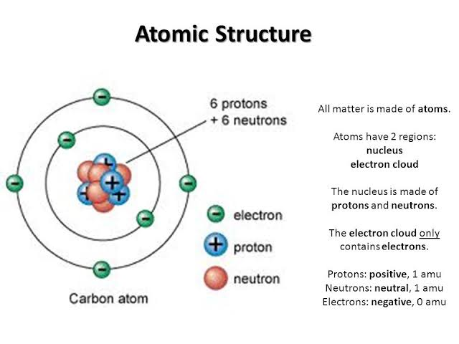
Engineering Chemistry
8

Slide 20
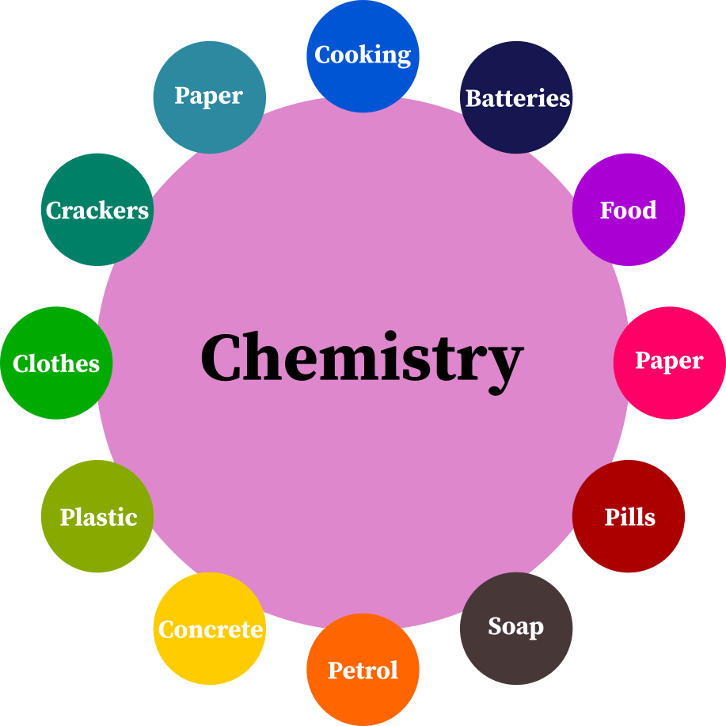
Scope of Chemistry
12

Slide 21
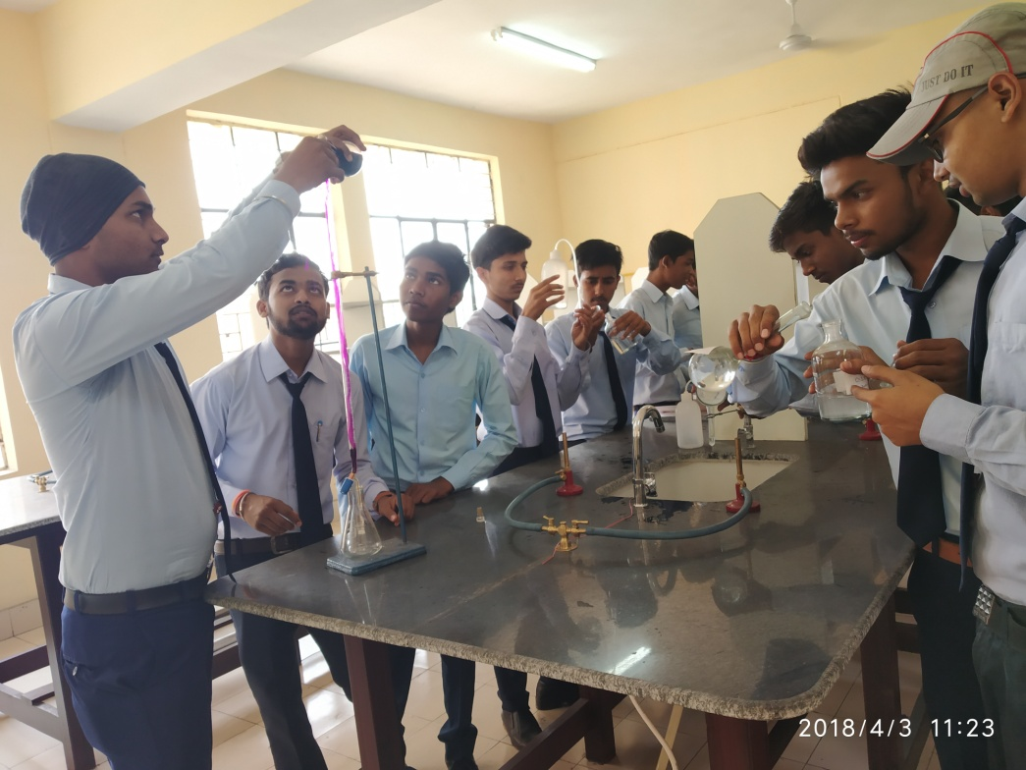
Laboratory
13

Slide 22
Laboratory
Electrochemistry
Electrochemistry is the branch of chemistry which deals with the relation
between chemical energy and Electrical energy.
Faraday’s law of Electrolysis:
Faraday’s first law of Electrolysis
Faraday’s second law of Electrolysis

Slide 23
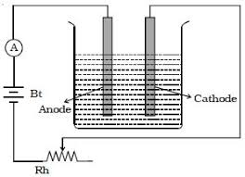
Laboratory
Faraday’s first law of Electrolysis:
The amount of substance liberated or deposited at a particular electrode
during electrolysis is directly proportional to the quantity of electricity
passed in the solution.

Slide 24
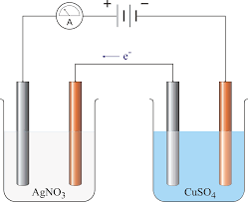
Laboratory
Faraday’s second law of Electrolysis:
When the same quantity of electricity is passed through the solution of
different electrolytes connected in series, the mass of the substance
liberated or deposited at the electrodes are directly proportional to their
equivalent mass.

Slide 25
Chandil Polytechnic Chandil
[106] Fundamental of Computer
Course outline
6

Slide 26
Status
Contents:
Introduction to Computer
Microsoft Office
Introduction to internet
HTML
Information technology.
7

Slide 27

Chandil Polytechnic, Chandil
            Introduction to Computer
Basic elements of a Computer.
8

Slide 28
Chandil Polytechnic, Chandil
Basic components of a computer system
Hardware: Tangible or which can be touched
b) Software: Set of instructions about what to do and how to perform a particluar task.
8

Slide 29
Chandil Polytechnic, Chandil
Storage unit
Input Unit
Hardware
Output Unit
Processor
8

Slide 30

Chandil Polytechnic, Chandil
System
Software
Application
9

Slide 31
Chandil Polytechnic, Chandil
Computer Memory
Primary Memory
Secondary Memory
Cache Memory
Registers.
10

Slide 32
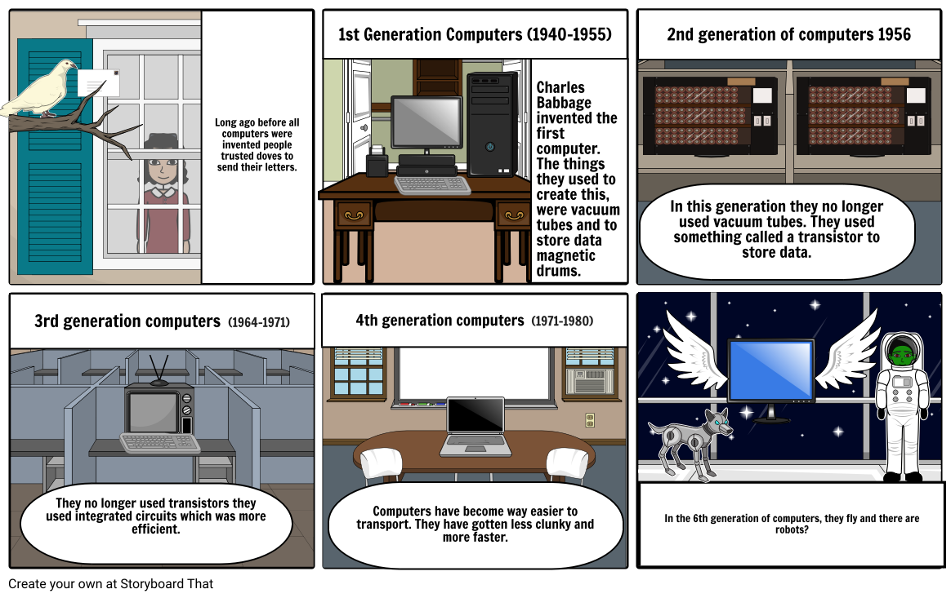
Generations of Computer
9

Slide 33
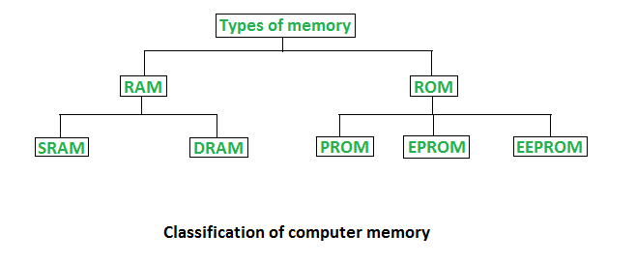
Chandil Polytechnic, Chandil
9

Slide 34

Chandil Polytechnic, Chandil
Introduction to Internet
History
Web Browser and Web Servers
Hypertext and WWW
9

Slide 35
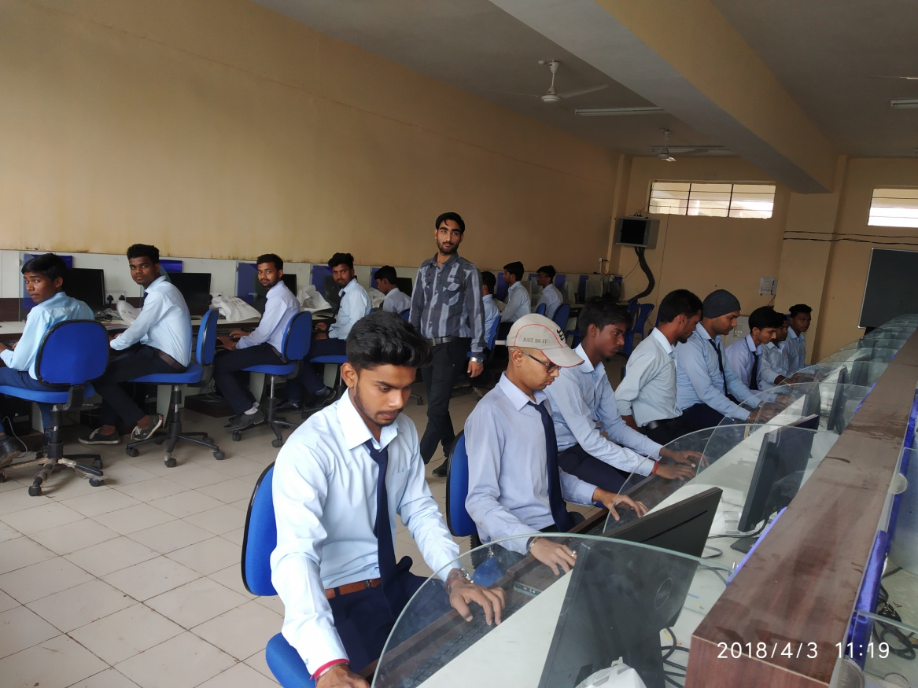
Laboratory
15

Slide 36
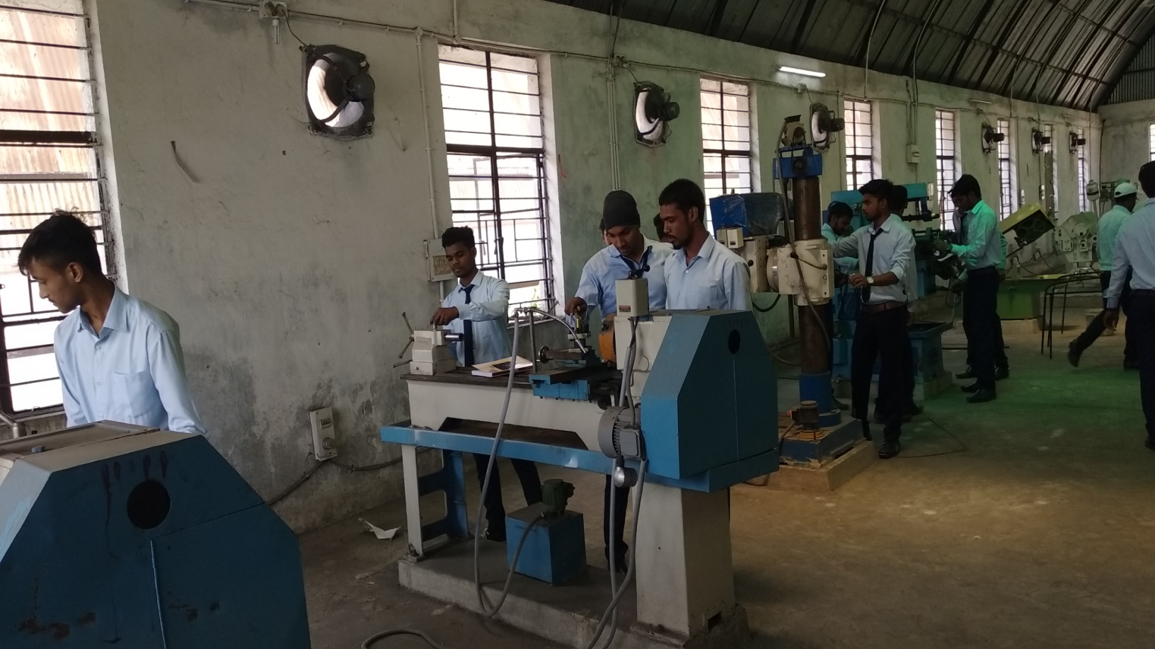
14

Slide 37
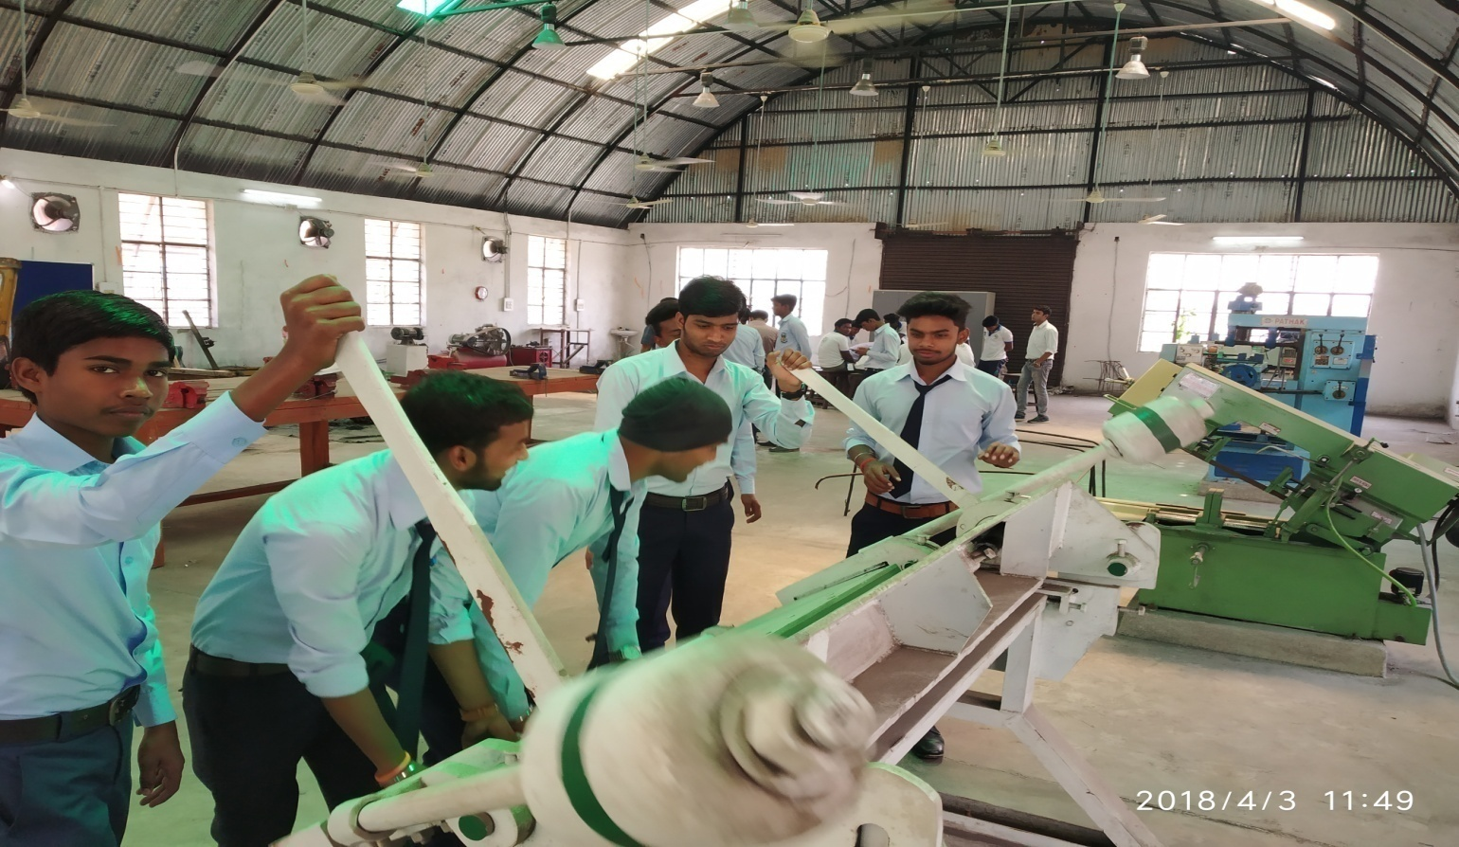
15

Slide 38
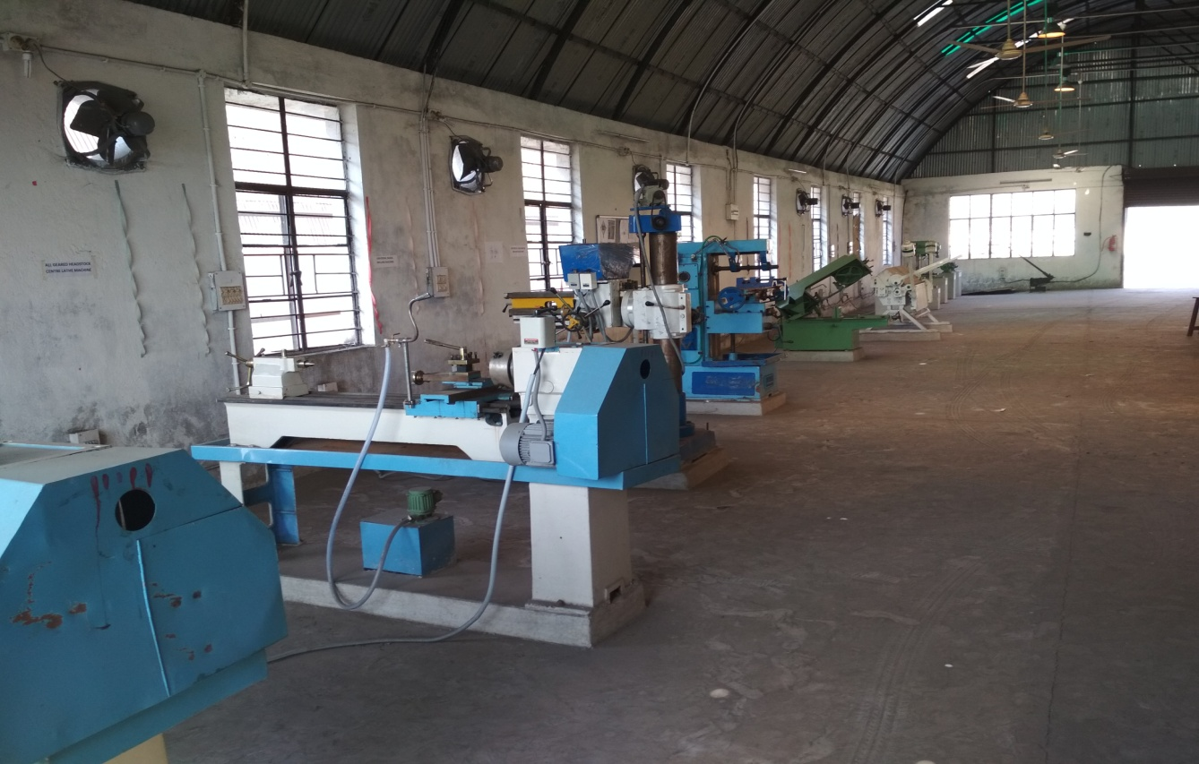
15

Slide 39
16

