Slide 1
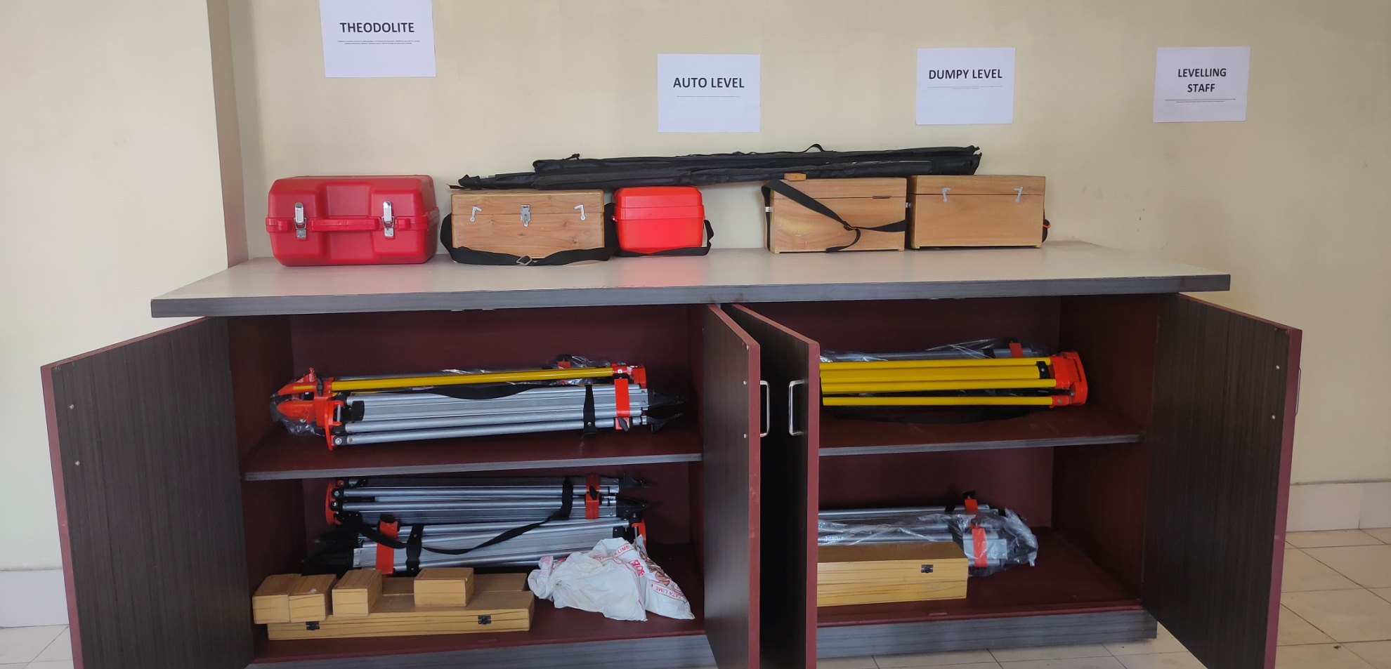
DEPARTMENT OF CIVIL ENGINEERING
PRESENTED BY:
Mr. Ajit Kumar

Slide 2
WHY CIVIL ENGINEERING ??
CIVIL IN BRIEF
Since time immemorial, human beings have been engaged in building all kinds of edifices. From huts made of mud to Taj Mahal, we have definitely come a long way.
Human beings had moved on to construct houses, palaces, canals, dams, highways etc.
Some significant structures from the past include the Stonehenge in Britain, the Great Pyramid of Giza, the Roman Coliseum, the Great Wall of China and the magnificent Taj Mahal.
Amongst all branches of engineering, the range and application of civil engineering is the broadest and the most visible. In fact, the entire infrastructural framework of a modern nation is the creation of civil engineers.

Slide 3
CIVIL ENGINEERING CAN BE SEEN AS -
There is huge demand for civil engineers in India and it is also expected to get a boost as the country gets ready to upgrade its infrastructure with growing economic .
There are equally good opportunities in the private sector for civil engineers. A major opening for qualified civil engineers is also in armed forces where they can make vital contribution to the protection of the country. Last but not the least you can set up your own engineering consultancy.

Slide 4
Mission and Vision of the department
Goal to achieve-
Deliver a industry oriented knowledge and prepare our students as a leaders with good leadership ability in industry, business and academic.
Develop linkages with Industry and educational institutions in Jharkhand for excellence in teaching, Soft Skills, Project and Technology.
Build a strong technical workforce that would bridge the gap between industry requirements and academic orientation.

Slide 5
VISION:
The civil Engineering Department of Chandil Polytechnic is driven to provide an conducive environment and educational experience from which students and faculty contribute to society for learning, creativity and problem solving skill
Induce entrepreneurial skills among students for contributing to the economic development of the nation.

Slide 6
NECESSITY IS THE MOTHER OF INVOVATION that’s the principle in which ENGINEERING works.
Here in civil engineering we are not only deal to DESIGN structure but at the same time we have to take proper care of it. That makes MAINTAINANCE as a inseparable part of civil engineering.
If we talk about maintenance then it should be feasible only when if the work execution should be proper thus it makes EXECUTION also as a inseparable part of civil engineering.
A Proficient Civil Engineer Must Have To Deal With –
Construction engineering
Hydraulic engineering
Transportation engineering
Structural engineering
Environment engineering and many more areas.

Slide 7
If you have decided to become a civil engineer then there are two options available. You can either go in for a DIPLOMA or DEGREE in civil engineering.
After successful completion of this diploma/degree course, you can go for a graduation /post-graduate course if you are interested in research or teaching
For a qualified civil engineer, there is no dearth of jobs, in both government departments and private organisations.
As a civil engineer, you will have to plan out, design and supervise the construction of different types of buildings.
Colleges offering programs in civil engineering generally extend scholarships to students from socially and economically backward classes.
Scholarships, free ships, stipends and financial assistance are also provided to students on the basis of merit and other qualifying criteria.

Slide 8
COURSE STRUCTURE OF CIVIL ENGINEERING
It consists of three year in diploma, each there is 2 sem of 6 months each.
Among those three first year(1st and 2nd sem) have same syllabus.
2nd and 3rd year are designed as per to enhance educational as well as institutional knowledge skill.
During this period students have to visit various sites (including construction and established structure ,viz DAM, BRIDGE etc. )
At end of syllabus they have to PREPARE A PROJECT which is suppose to reflect their interest and knowledge.

Slide 9
2nd year
3rd sem
Engg Maths III
Surveying
Building material
Strength of material
5. Building design
4th sem
Construction Technology
Geo Technical Engg
Hydraulics
4. Theory of Structure
5. Transportation Engg.
3rd year
5th sem
1. Irrigation engg
2. RCC Design
3. Adv Surveying
4. Environmental Engineering .
5.Elective
6th sem
1.Industrial Engg & Mgt.
2.Design of Steel Structure 3.Estimating & Costing
4.Contract & Account
5.Project / research

Slide 10
JOB OPPORTUNITIES
1. GOVERNMENT SECTOR
PLANNING
DESIGNING
MAINTAINANCE
JobS in : SSC , PSUs ,BHEL , GAIL ,CIL etc.
2. PRIVATE SECTOR
LARSEN AND TUBRO
GAMMON INDIA LTD.
IVRCL INFRASTRUCTURE & PROJECTS LTD
JAYPEE GROUP
VARIOUS CONSTRUCTION COMPANIES.

Slide 11
WHY CPC ?
Because of its peaceful environment.
Because of locality it is next to CHANDIL DAM, a hydraulic structure which consists of lots of engineering aspects.
Wide range of lab set up which give primary knowledge necessary to civil engineers.
Semi govt college (PPP mode) collaborated with JIS group, biggest educational institutional group of eastern India. That makes easier placement for diploma passing aspirants.
Expert lectures , Institution Industry Interaction program at frequent.
These create less diversion and more focused study.

Slide 12
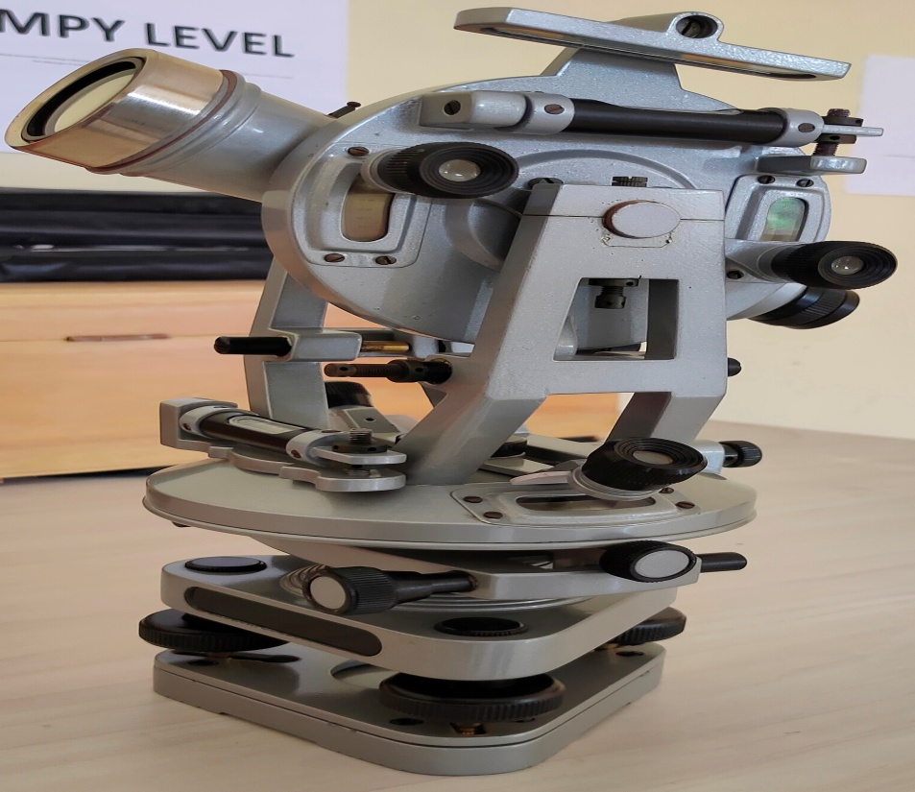
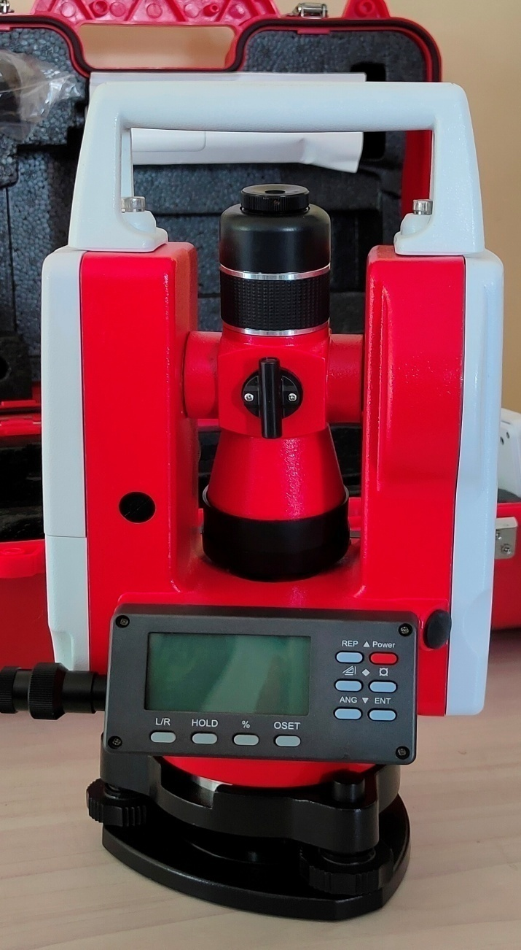
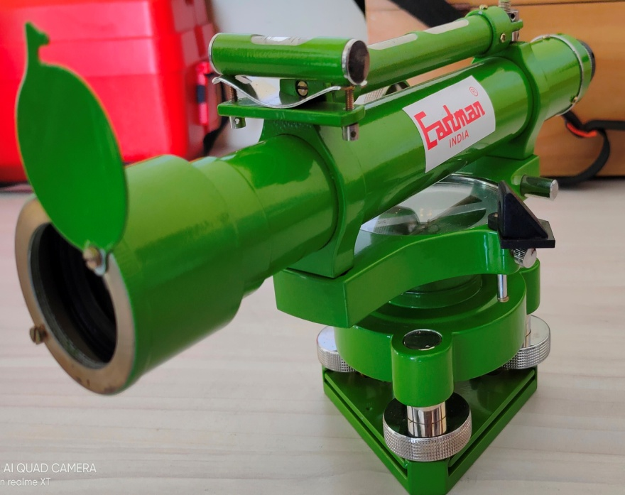

Slide 13
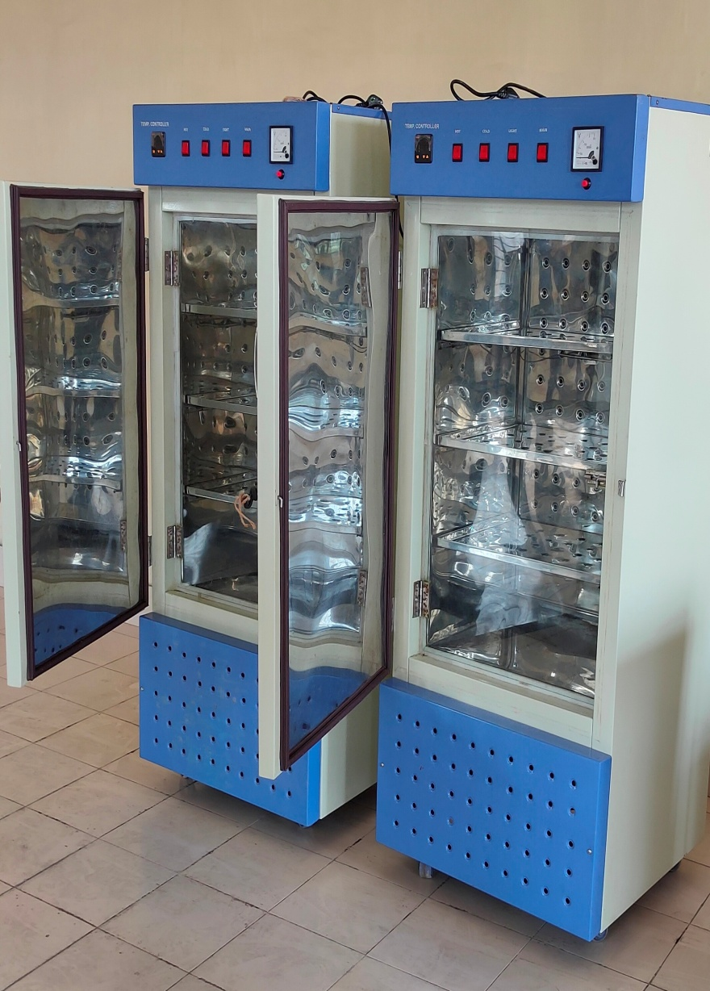
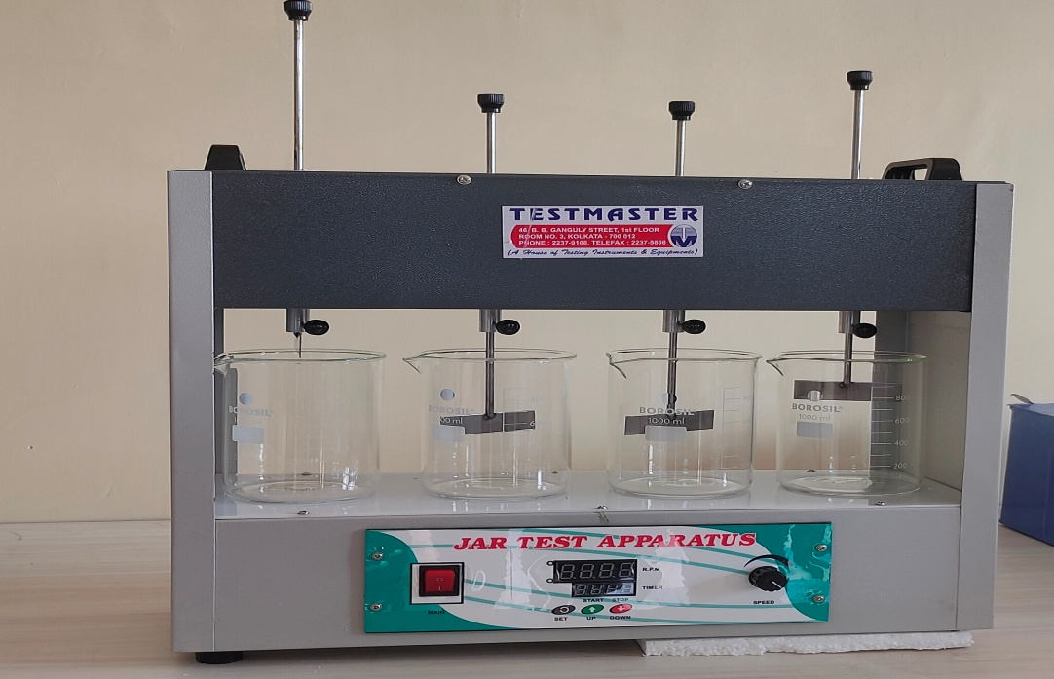
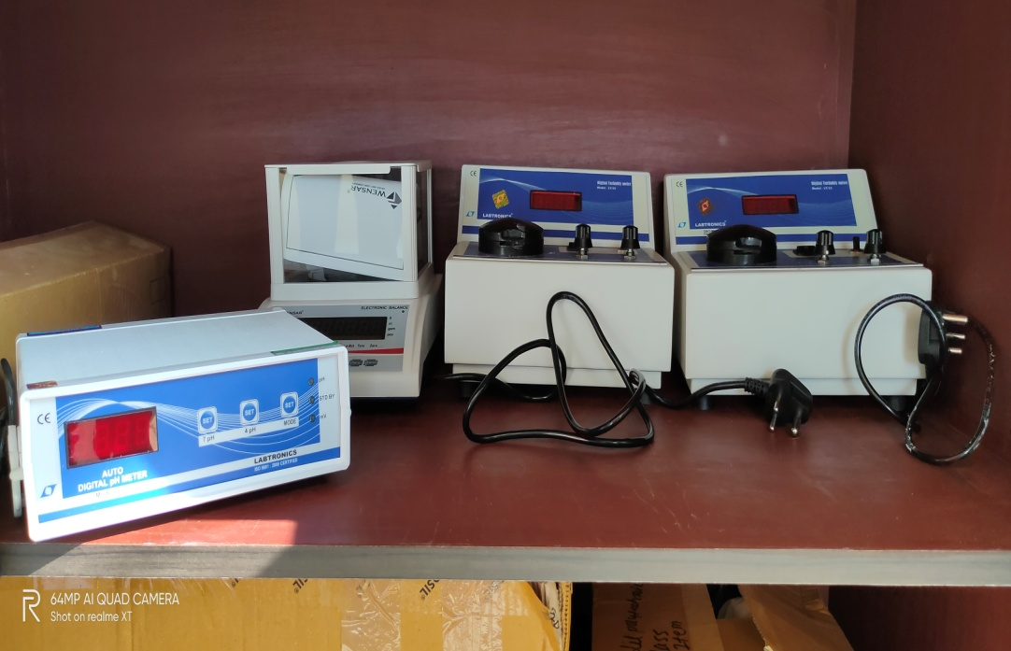

Slide 14
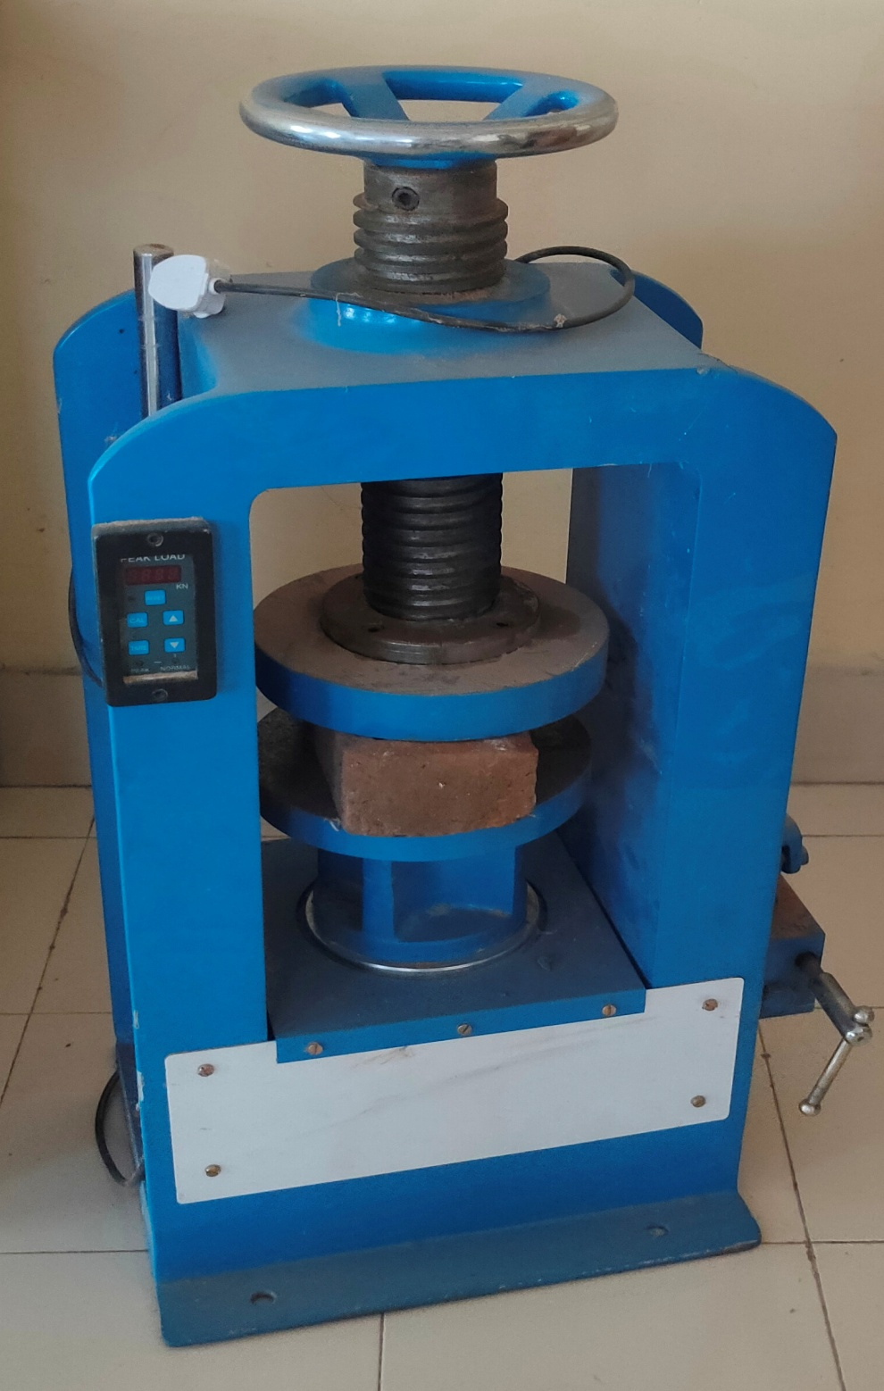
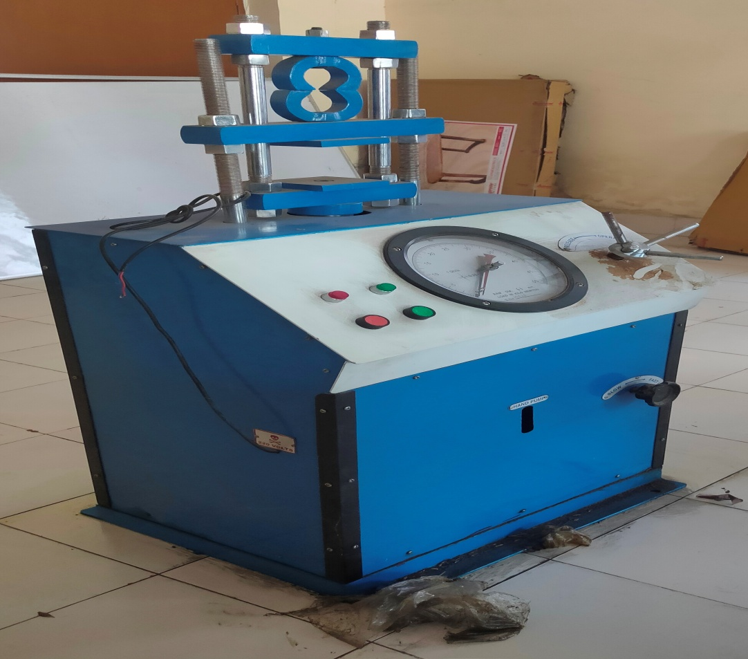
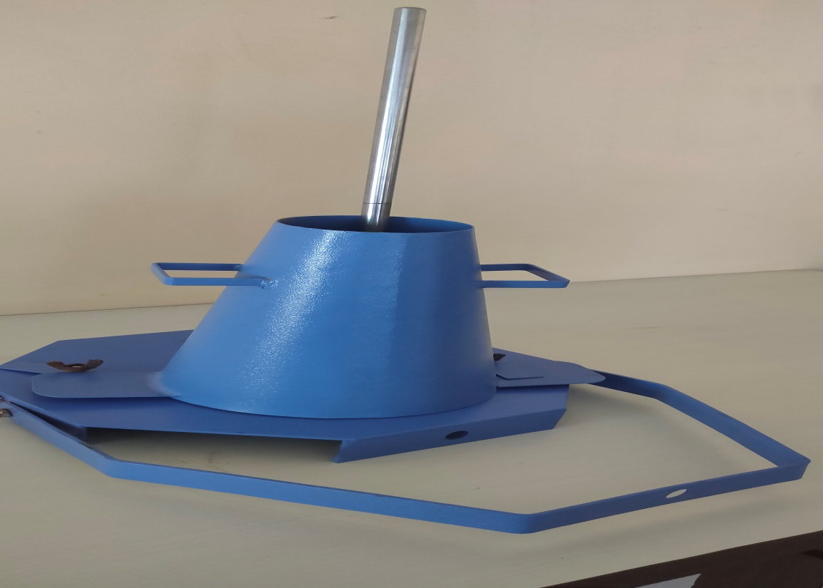

Slide 15
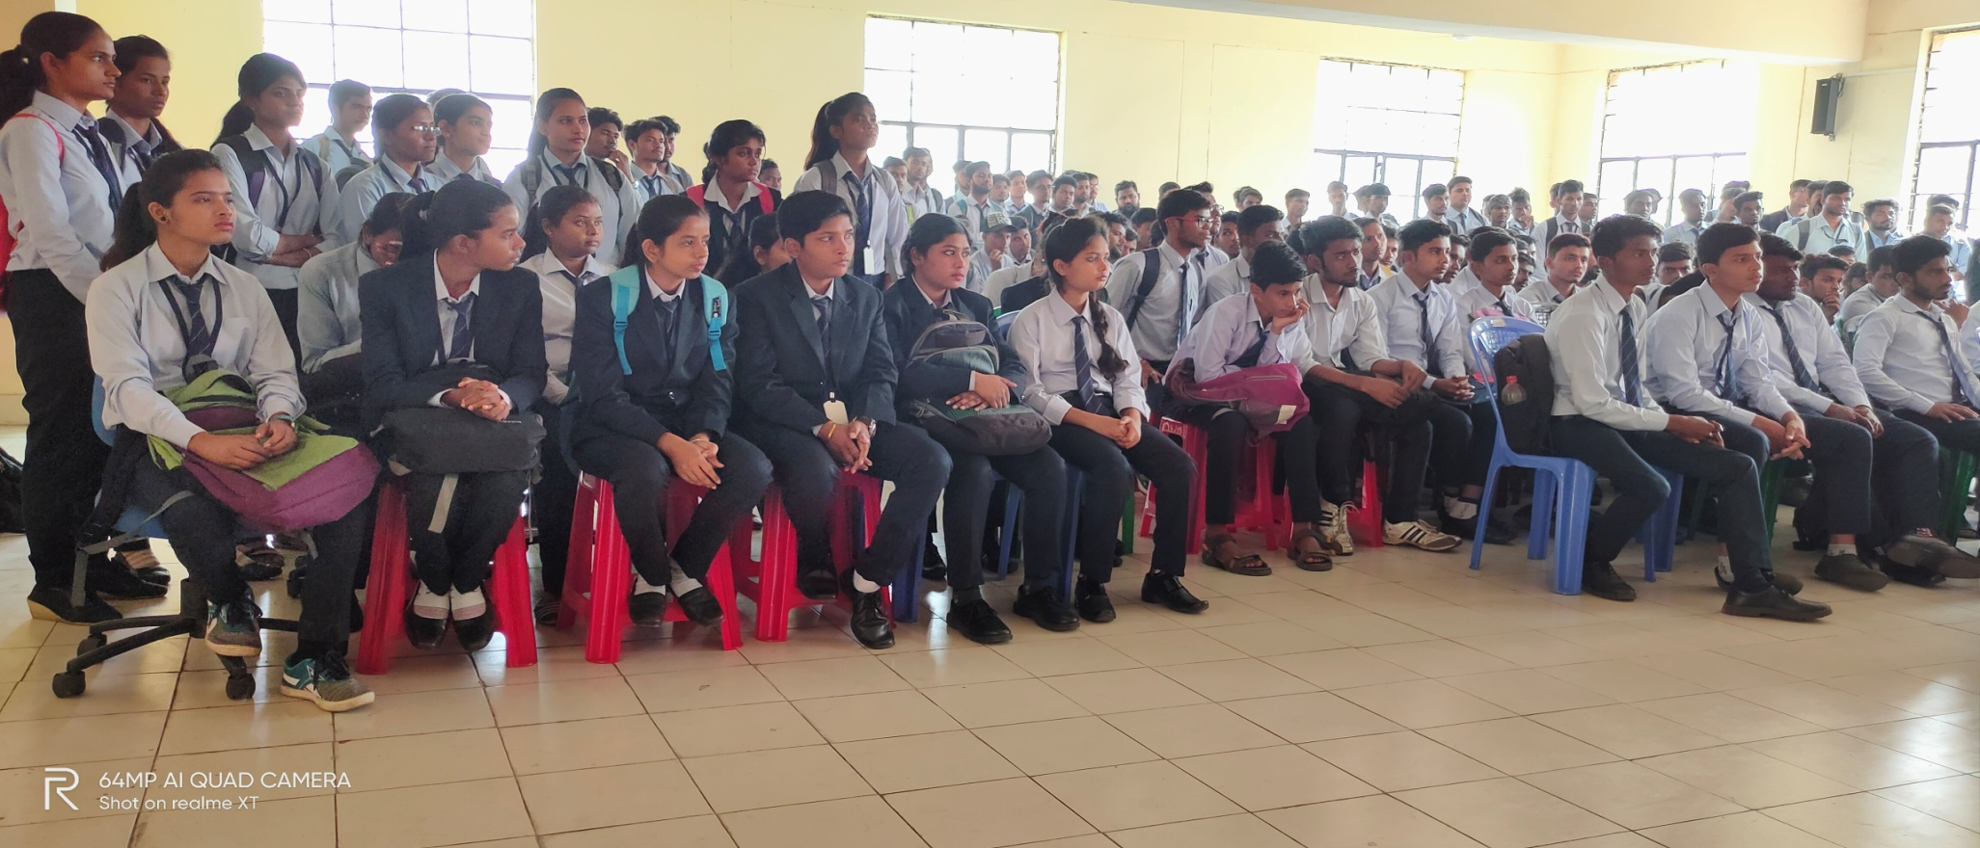
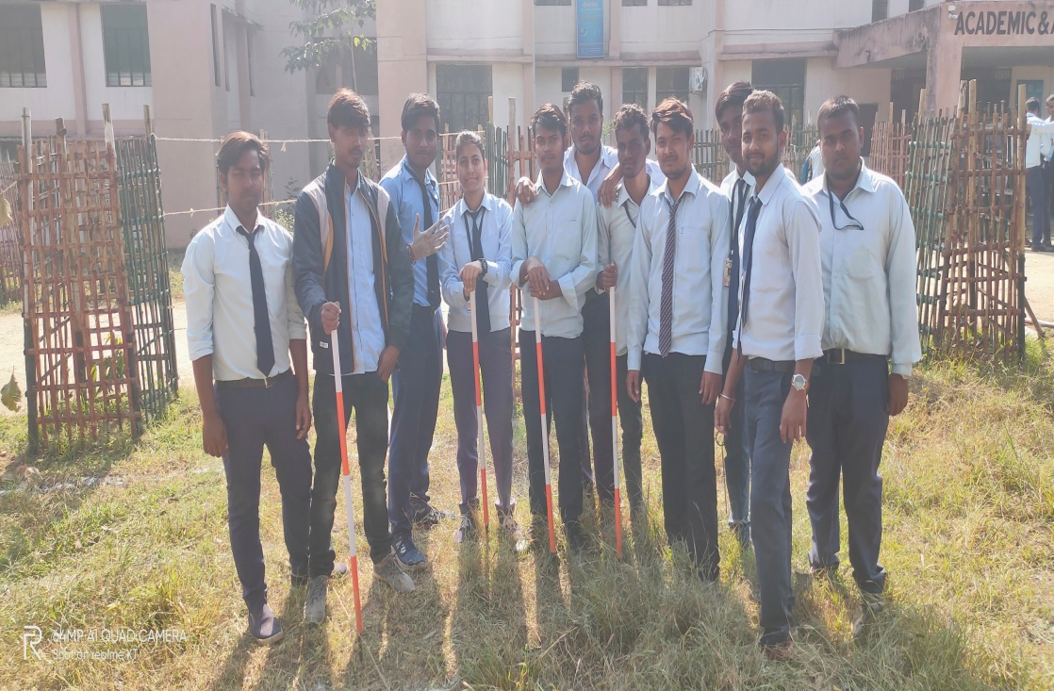
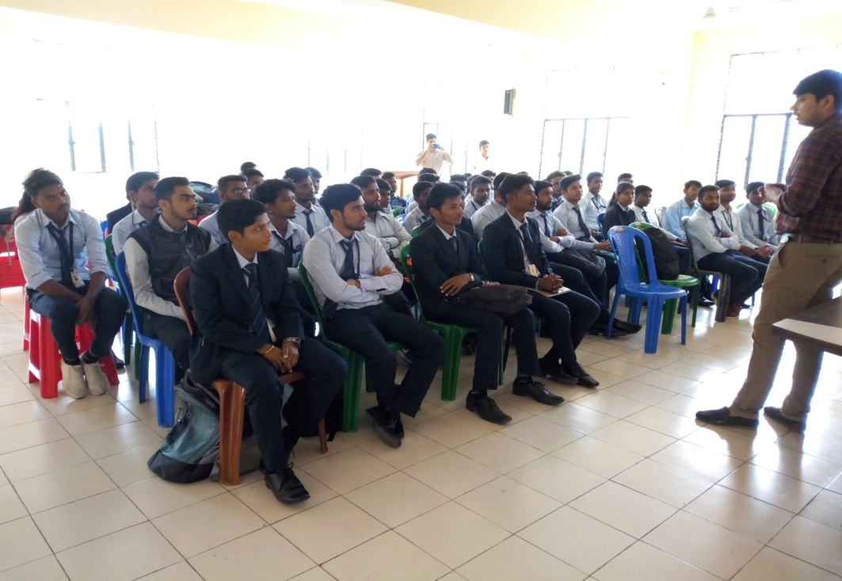

Slide 16
It is
PLANNING,
DESIGING,
EXECUTION and MAINTAINANCE
is just next to
CIVIL ENGINEERING.

Slide 17
THANKS TO ALL.
HAVE A SPLENDID DAY AHEAD
REGARDS –
AJIT KUMAR
Lecturer
Civil engineering dept.
Chandil Polytechnic Chandil.

