Slide 1
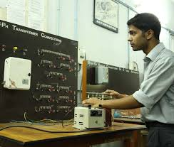
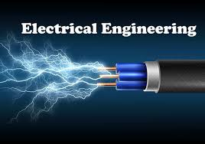
Department of Electrical Engineering
Presentation
by
Mr G K Sah

Slide 2
Mission and Vision of the department
    Overview
        What is Mechanical Engineering ?
    At Polytechnic
      What is so special about ME program at Poly?
    Details of the ME Curriculum
      Aerospace Engineering Concentration
    What will you be when you graduate
      Poly Alumni
      Prospective Employers
VISION:
It is aimed to provide the finest environment for teaching, learning, research, innovation and character building so as to mould youth of today into world-class technocrats of tomorrow who would Endeavour to increase the quality of life for mankind.

Slide 3
Mission and Vision of the department
MISSION:
Deliver a industry oriented knowledge and prepare our students as a leaders with good leadership ability in industry, business and academic.
Develop linkages with Industry and educational institutions in Jharkhand for excellence in teaching, Soft Skills, Project and Technology.
Build a strong technical workforce that would bridge the gap between industry requirements and academic orientation.
Provide an conducive environment and educational experience from which students and faculty contribute to society for learning, creativity and problem solving skill
Induce entrepreneurial skills among students for contributing to the economic development of the nation.
    Overview
        What is Mechanical Engineering ?
    At Polytechnic
      What is so special about ME program at Poly?
    Details of the ME Curriculum
      Aerospace Engineering Concentration
    What will you be when you graduate
      Poly Alumni
      Prospective Employers

Slide 4

Electrical Engineering
Electrical engineers design, develop, test, and supervise the manufacturing of electrical equipment, such as electric motors, radar and navigation systems, communications systems, and power generation equipment.

Slide 5
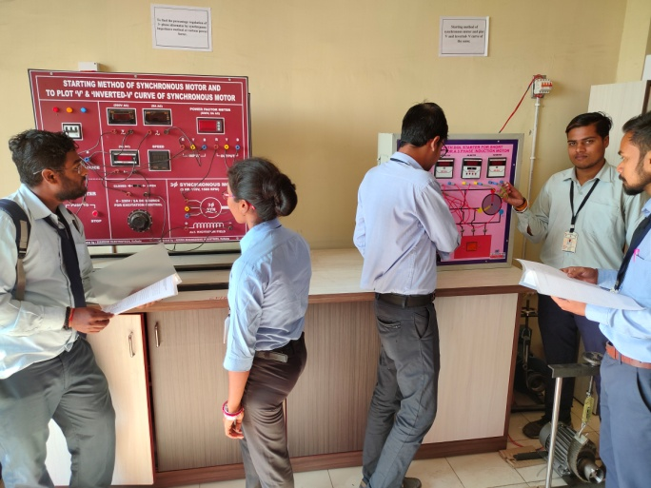
Electrical Engineering (continued)
Diploma in Electrical Engineering
  A new curriculum with effect from 2017
  6 semesters; 3 year program
  It is a professional course
  Hands-on laboratory, and Workshop
  Focus on communication skills
  (we teach you to say what you mean)

Slide 6
Course Structure
Common 1st and 2nd semester
3rd semester
Engineering Math – III
Electrical Engineering
Measurement
Basic Engineering (C & M)
Electronics Engineering

Slide 7
Course Structure
4th semester
Network Theory
Electrical Machine I
Digital Circuit & Microprocessor
Elect Estimation & Costing
Power System I

Slide 8
Course Structure
5th semester
Power System II
Electrical Machine II
Traction
Elective I
Elective II

Slide 9
Course Structure
6th semester
Industrial Engineering & Management
Utilization of Electrical Energy
Power Electronics
Elective I
Elective II

Slide 10
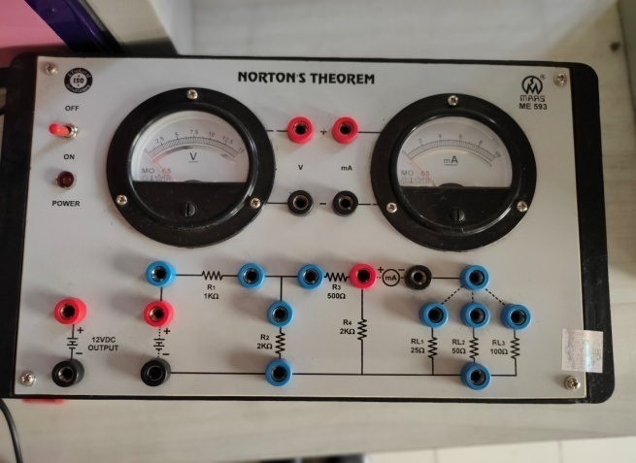
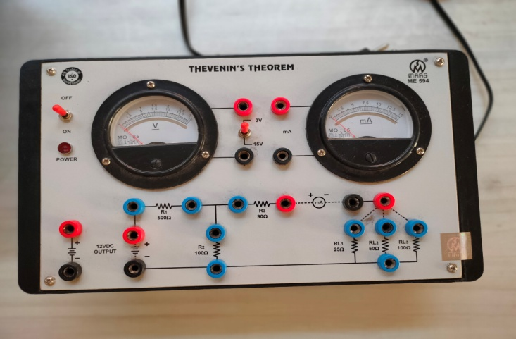
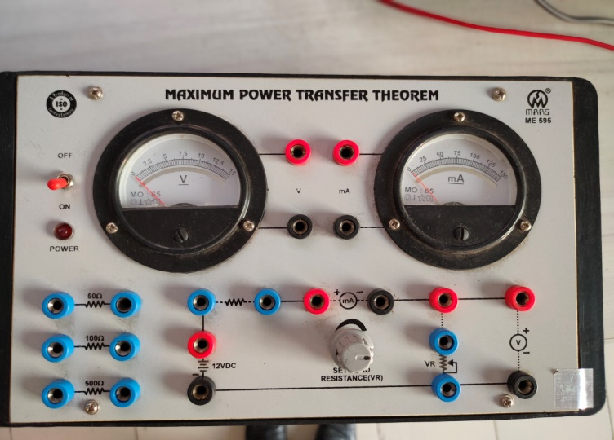
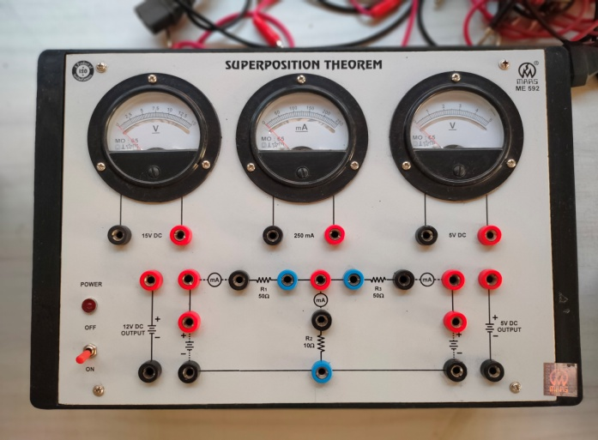
Some Photograph Of:
Network Lab
Norton’s Theorem
Thevenin’s Theorem
Superposition Theorem
Maximum Power Theorem

Slide 11
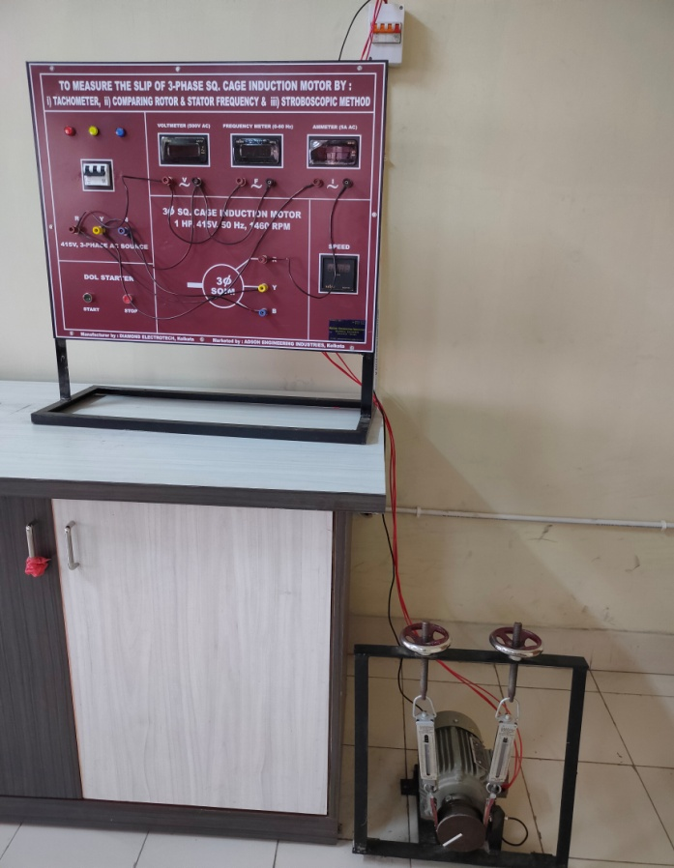
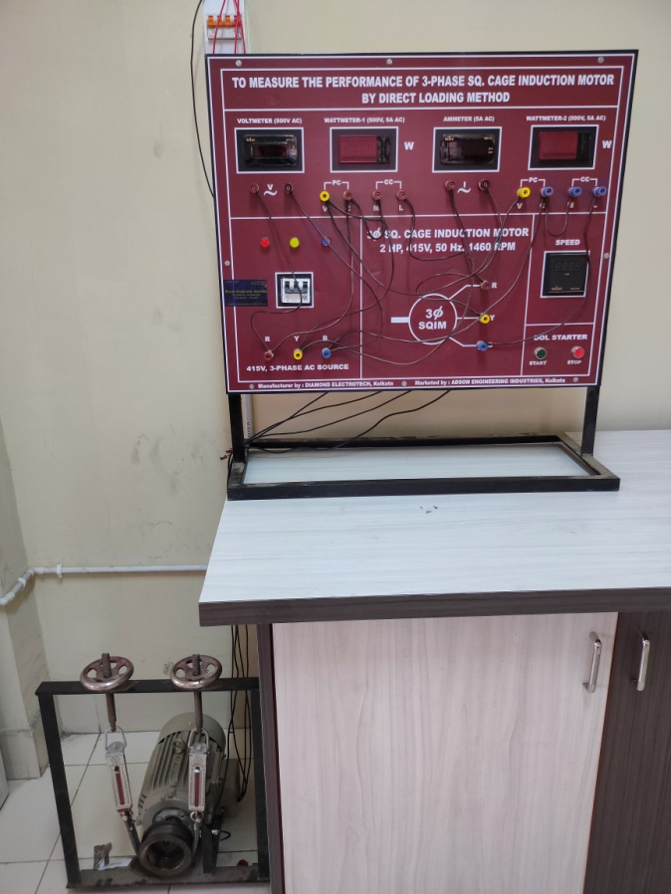
Machine Lab:
Measure the slip of 3-phase Sq. cage Induction Motor
Measure the Performance of 3-phase Sq. cage Induction Motor by Direct Loading Method

Slide 12
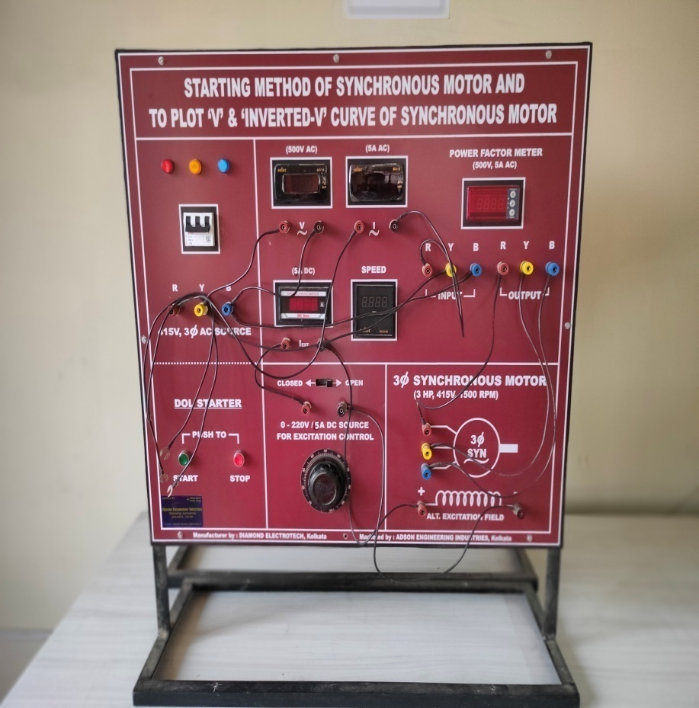
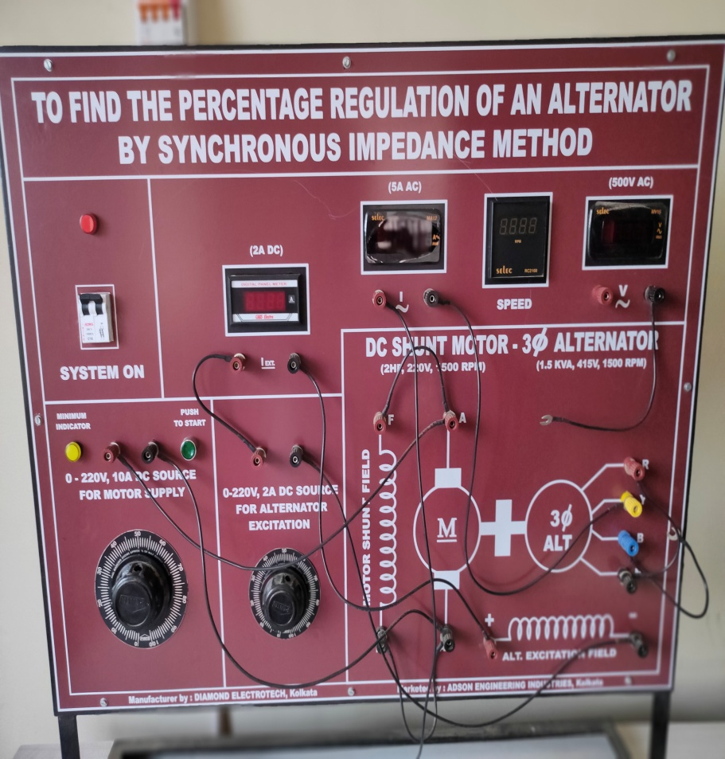
Starting method of Synchronous motor and to Plot ‘v’ & inverted ‘v’ curve of Synchronous motor
To find the percentage regulation of an aleternator by synchronous impedance method

Slide 13
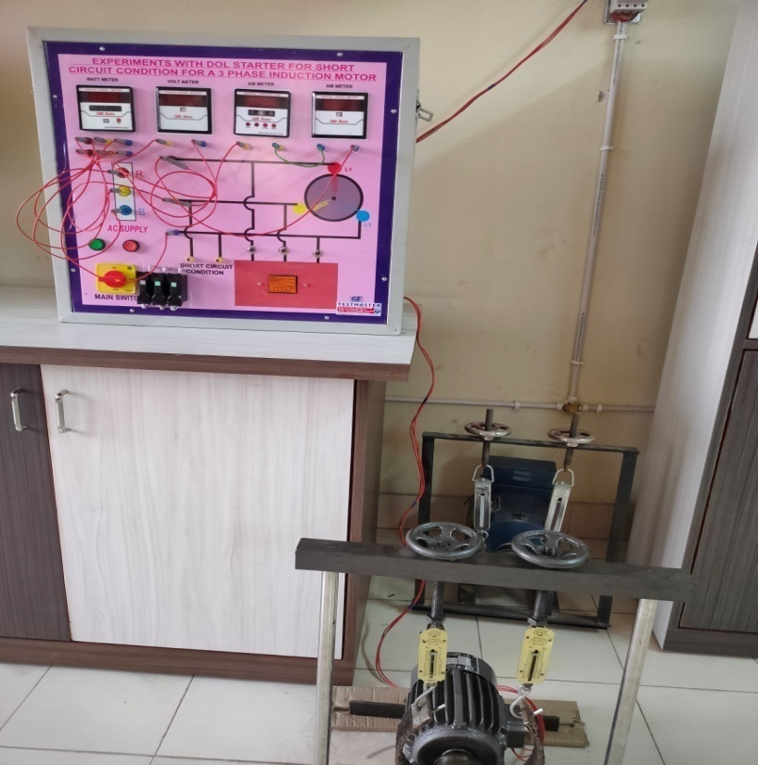
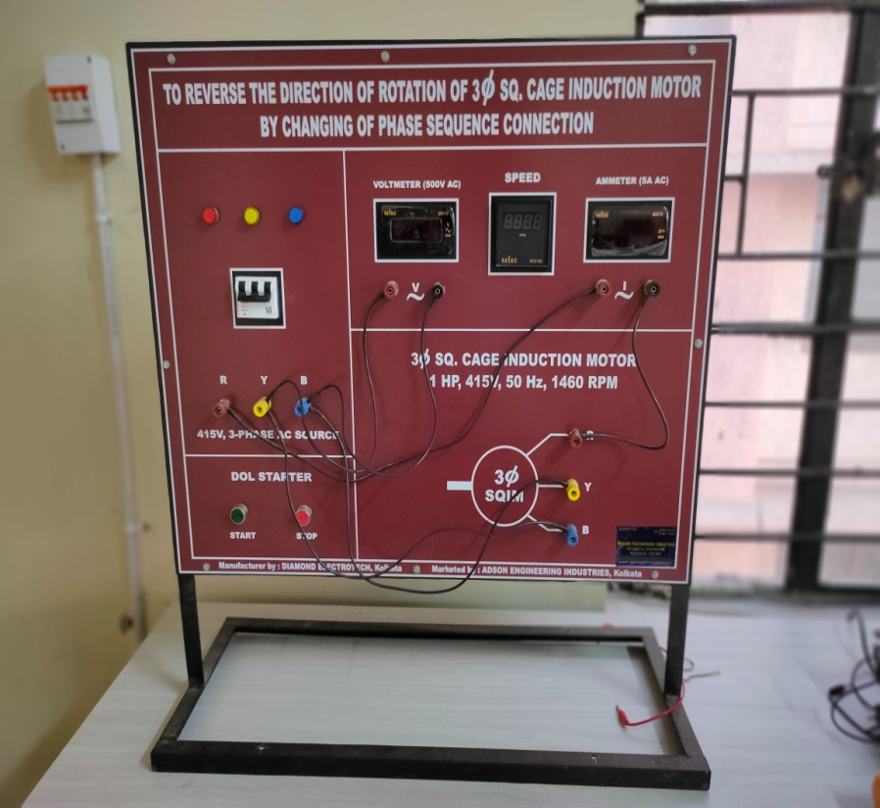
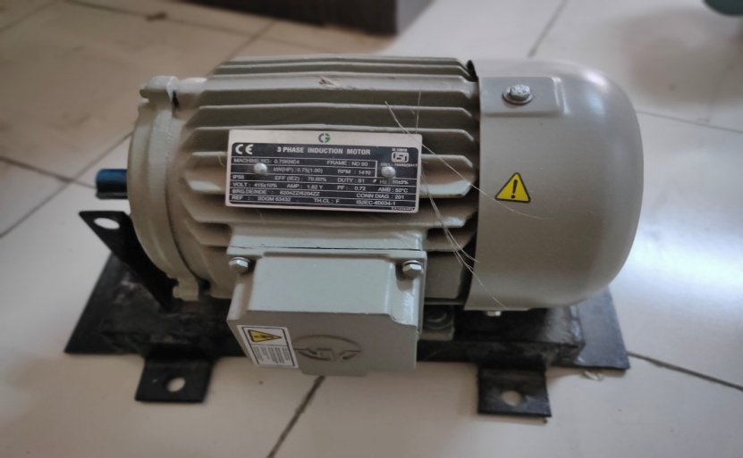
DOL Starter for Short Circuit Condition for a 3-phase Induction motor
To reverse the direction of rotation of 3 phase Sq. Cage Induction Motor By changing of phase sequence connection
3-phase Induction Motor

Slide 14
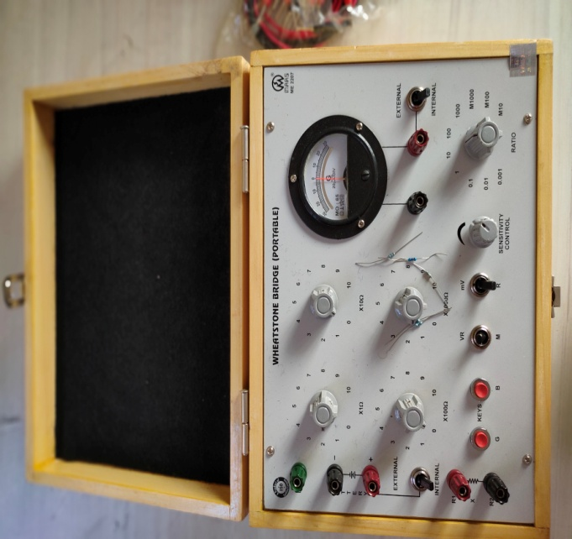
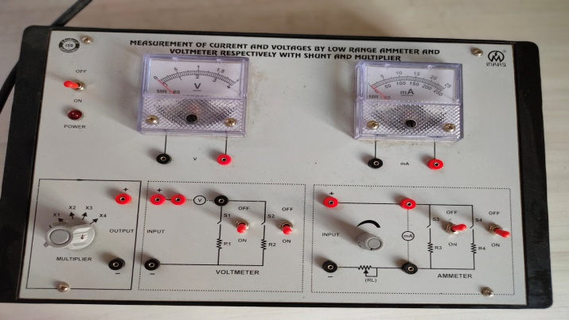
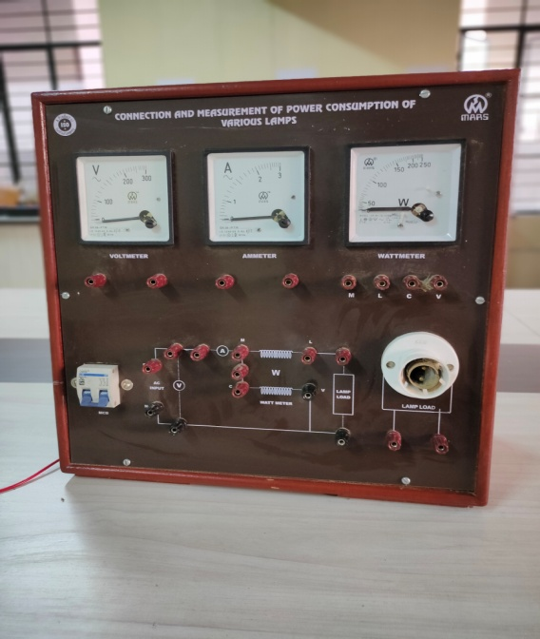
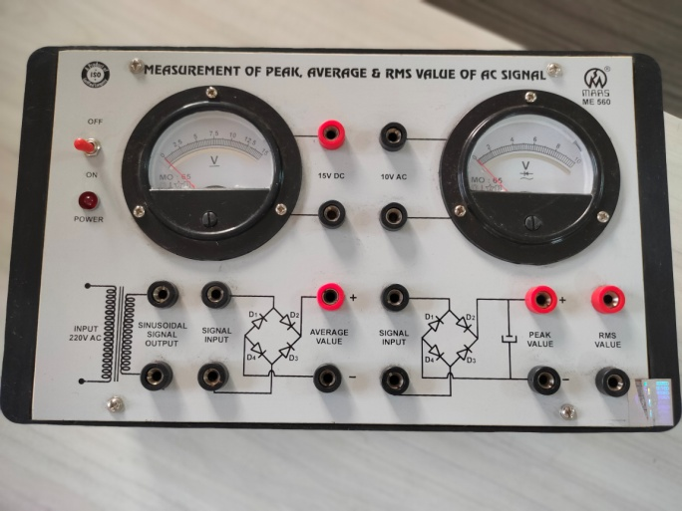
Measurement Lab:
Measurement of Current and Voltage by low range ammeter and voltmeter respectively with shunt and multiplier
Wheatstone Bridge
Measurement of Peak , Average & RMS Value of AC Signal
Power Consumption of Various Lamps

Slide 15
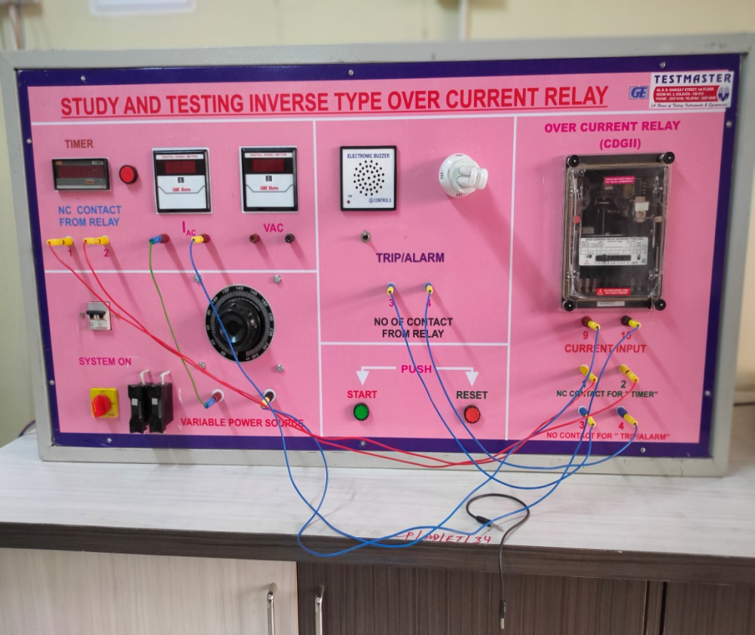
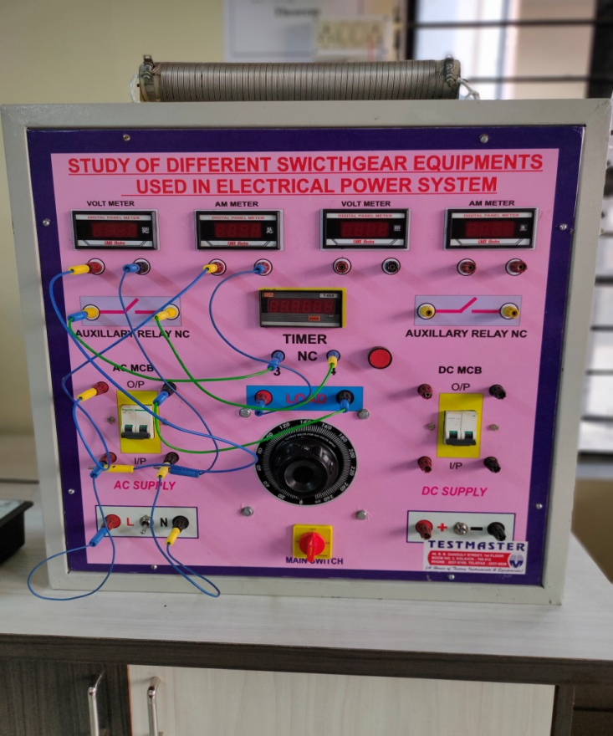
Power System Lab:
Study and Testing Inverse Type Over Current Relay
Study of Different Switchgear Equipments used in Electrical Power System

Slide 16
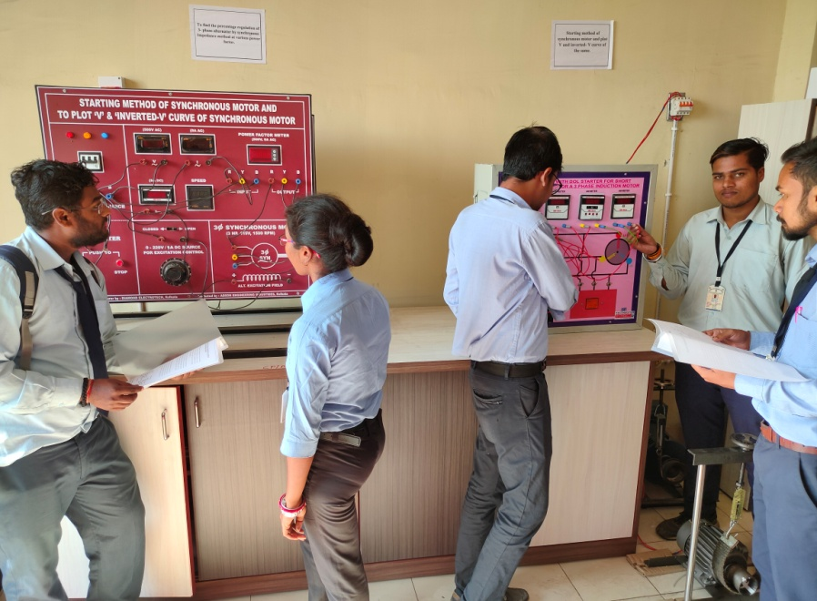
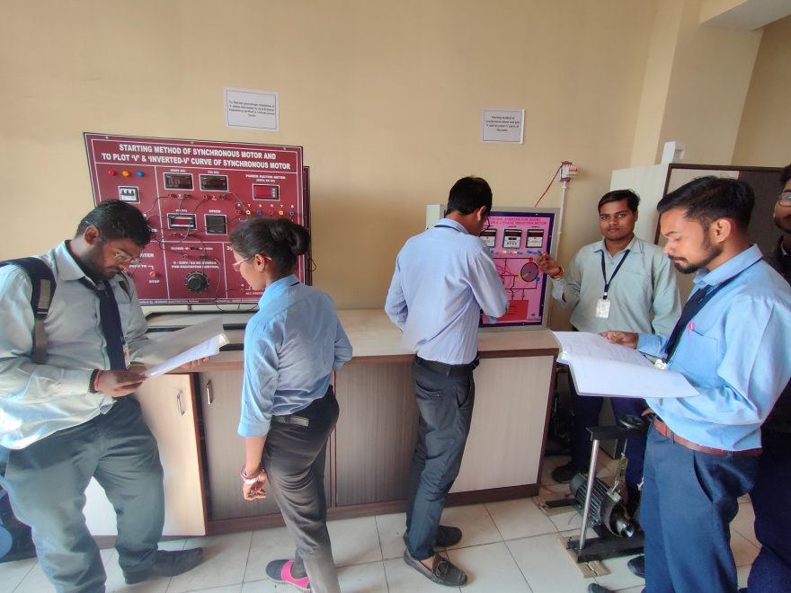
Students in lab

Slide 17
Question: Why choose
Electrical Engineering at Poly?
Electrical engineering makes you versatile
Your degree will have a great value
Work Experience with advance heavy equipment
Doors will open to you for great things!

Slide 18
What will you get in CPC!
  Professionals working in: industry, academia, government …..
  NPTEL
  Hands on experience
  Advance workshop
  Personality development classes
  Goal oriented teaching

Slide 19
Career
  ISRO, Railway,
  SSC JE,
  CIL,
  TATA STEEL,
  SAIL, NTPC, …. … ..

Slide 20


Thank You!

