Slide 1
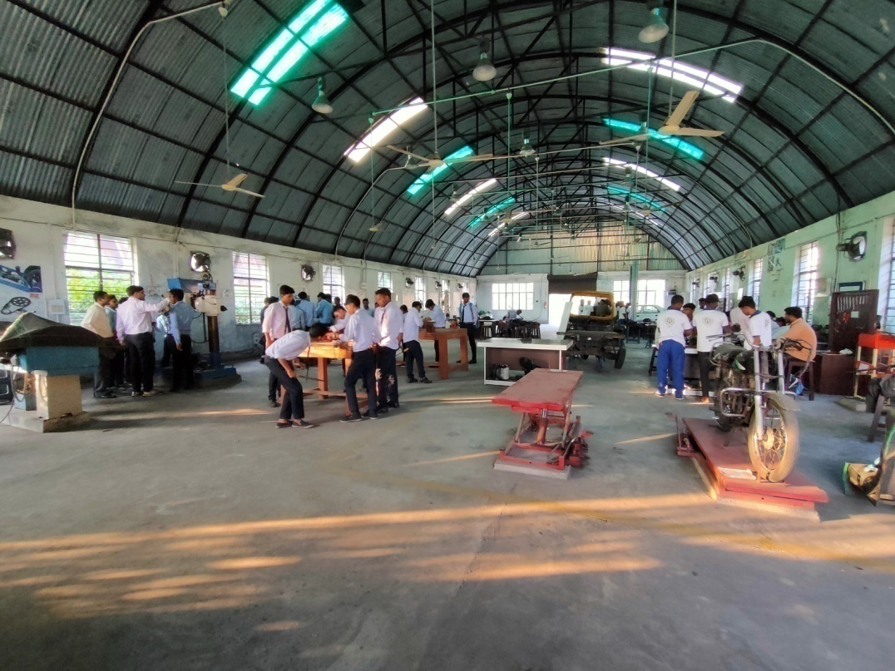
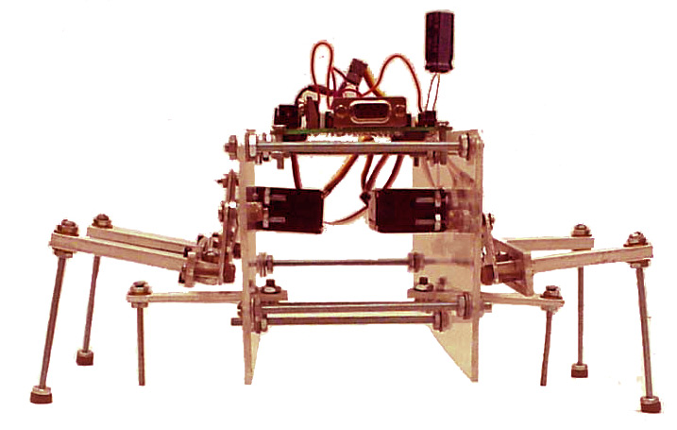
Department of Mechanical Engineering
Presentation
by
Mr J K Mishra

Slide 2
Mission and Vision of the department
    Overview
        What is Mechanical Engineering ?
    At Polytechnic
      What is so special about ME program at Poly?
    Details of the ME Curriculum
      Aerospace Engineering Concentration
    What will you be when you graduate
      Poly Alumni
      Prospective Employers
VISION:
The Mechanical Engineering Department of Chandil Polytechnic strives to be recognised for quality engineering education who are innovative, entrepreneurial and successful in achieving excellence in their field of study.

Slide 3
Mission and Vision of the department
MISSION:
Deliver a industry oriented knowledge and prepare our students as a leaders with good leadership ability in industry, business and academic.
Develop linkages with Industry and educational institutions in Jharkhand for excellence in teaching, Soft Skills, Project and Technology.
Build a strong technical workforce that would bridge the gap between industry requirements and academic orientation.
Provide an conducive environment and educational experience from which students and faculty contribute to society for learning, creativity and problem solving skill
Induce entrepreneurial skills among students for contributing to the economic development of the nation.
    Overview
        What is Mechanical Engineering ?
    At Polytechnic
      What is so special about ME program at Poly?
    Details of the ME Curriculum
      Aerospace Engineering Concentration
    What will you be when you graduate
      Poly Alumni
      Prospective Employers

Slide 4
Agenda
    Overview
        What is Mechanical Engineering ?
    At Polytechnic
      What is so special about ME program at Poly?
    Details of the ME Curriculum
      Aerospace Engineering Concentration
    What will you be when you graduate
      Poly Alumni
      Prospective Employers
Overview
What is Mechanical Engineering ?
    At Polytechnic
      What is so special about ME program at Poly?
    Details of the ME Curriculum
    What do mechanical engineers do?
    Career after Diploma

Slide 5
Top Ten ME Achievements in the 20th Century
    The Automobile
    Power Generation
    Agricultural Mechanization
    The Airplane
    Integrated Circuit Mass Production
    Air-conditioning and refrigeration
    Computer-aided engineering technology
    Bioengineering
    Codes and standards
    Many More
Source: Wicket, An Introduction to Mechanical Engineering, 2004

Slide 6
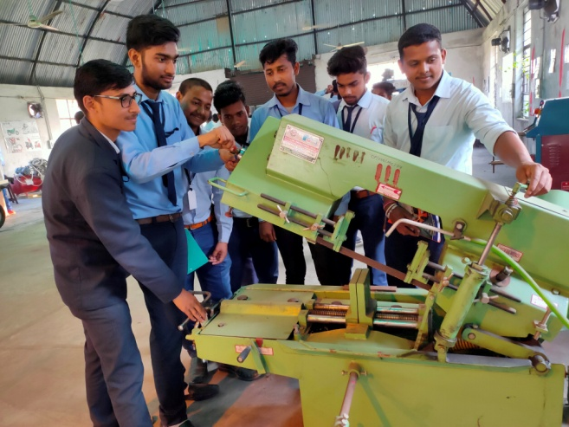
Mechanical Engineering
Our students:
  Are highly motivated
  Have a good sense of where they want to go
  Most work during the academic year
  Vast majority has substantial engineering experience

Slide 7
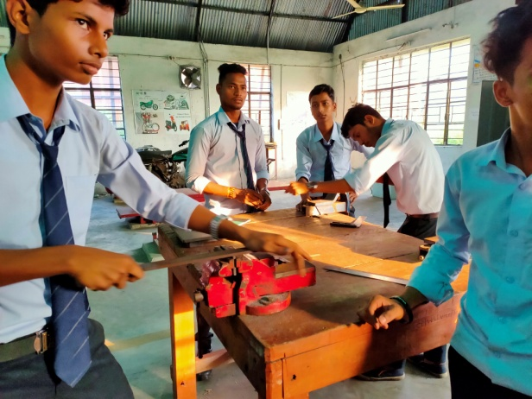
Mechanical Engineering (continued)
Diploma in Mechanical Engineering
  A new curriculum with effect from 2017
  6 semesters; 3 year program
  It is a professional course
  Hands-on laboratory, and Workshop
  Focus on communication skills
  (we teach you to say what you mean)

Slide 8
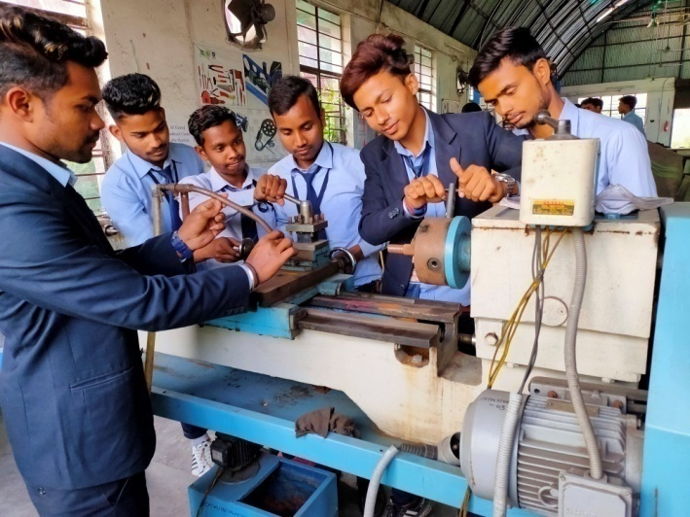
Mechanical Engineering (continued)
A program that emphasizes:
    - modern computing tools and equipment
    - engineering design
    - engineering practice
    - projects,
    - national student competitions
    - interests, resources, and faculty knowledge
    - competitive annual
    design awards

Slide 9
Question: Why choose
Mechanical Engineering at Poly?
Mechanical engineering makes you versatile
Your degree will have a great value
Work Experience with advance heavy equipment
Doors will open to you for great things!

Slide 10
What will you get in CPC!
  Professionals working in: industry, academia, government …..
  NPTEL
  Hands on experience
  Advance workshop
  Personality development classes
  Goal oriented teaching

Slide 11
Course Structure
Common 1st and 2nd semester
3rd semester
Engineering Math – III
Machine Drawing
Engineering Materials
Engineering Mechanics
Strength of Materials

Slide 12
Course Structure
4th semester
Manufacturing Technology
Fluid Mechanics & Machine
Thermal Engg
Theory of Machine
Electrical Engg

Slide 13
Course Structure
5th semester
Power Engineering
Adv. Manufacturing Technology
Metrology & Quality Control
Electronics Engineering
Elective 1

Slide 14
Course Structure
6th semester
Industrial Engineering & Management
Design of Machine Elements
Industrial Fluid Power
Measurements & Automation
Elective-II

Slide 15
Career
  ISRO, Railway,
  SSC JE,
  CIL,
  TATA STEEL,
  SAIL, NTPC, …. … ..

Slide 16
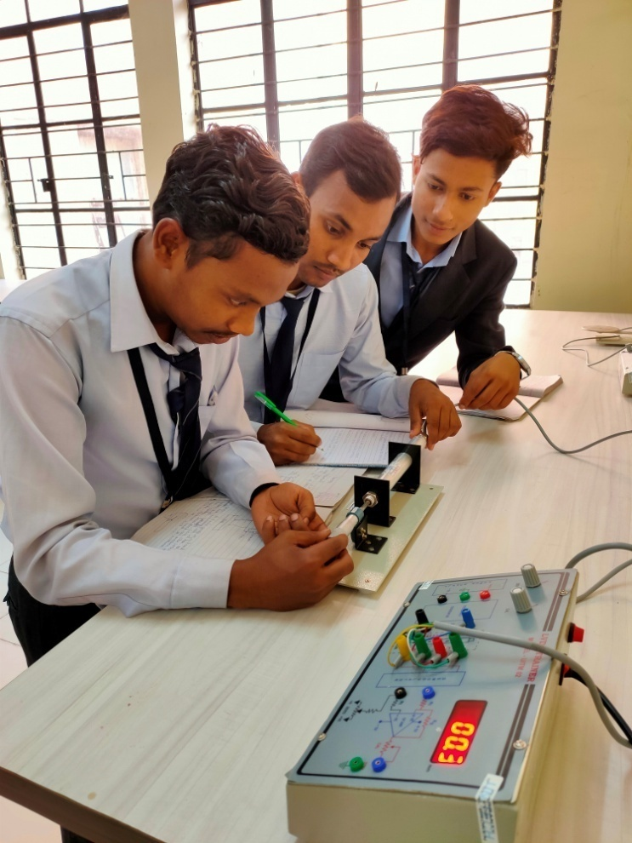
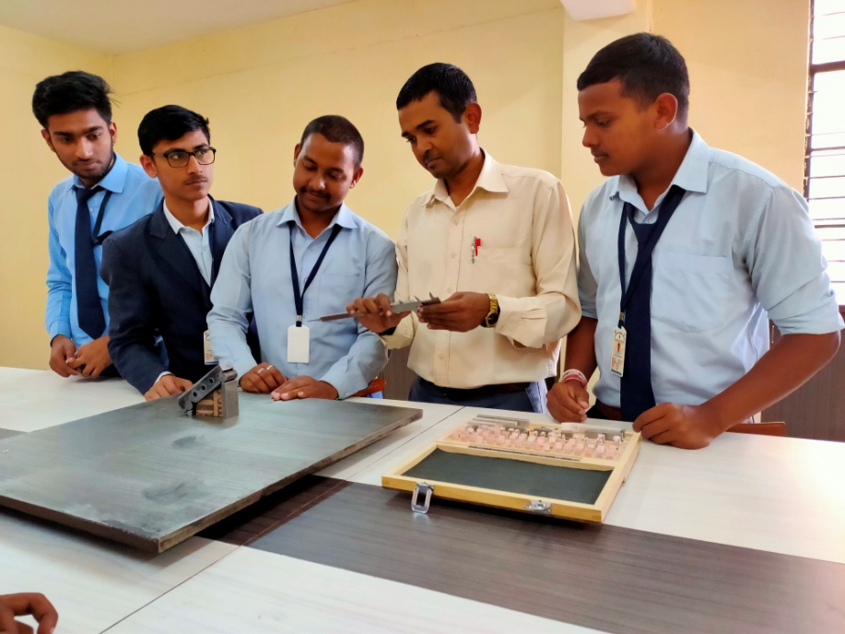
Some Photographs
The Metrology Lab

Slide 17
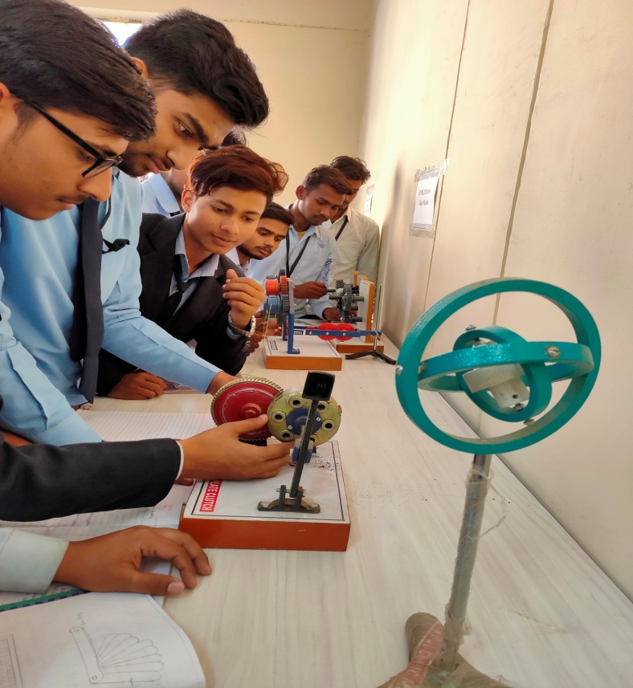
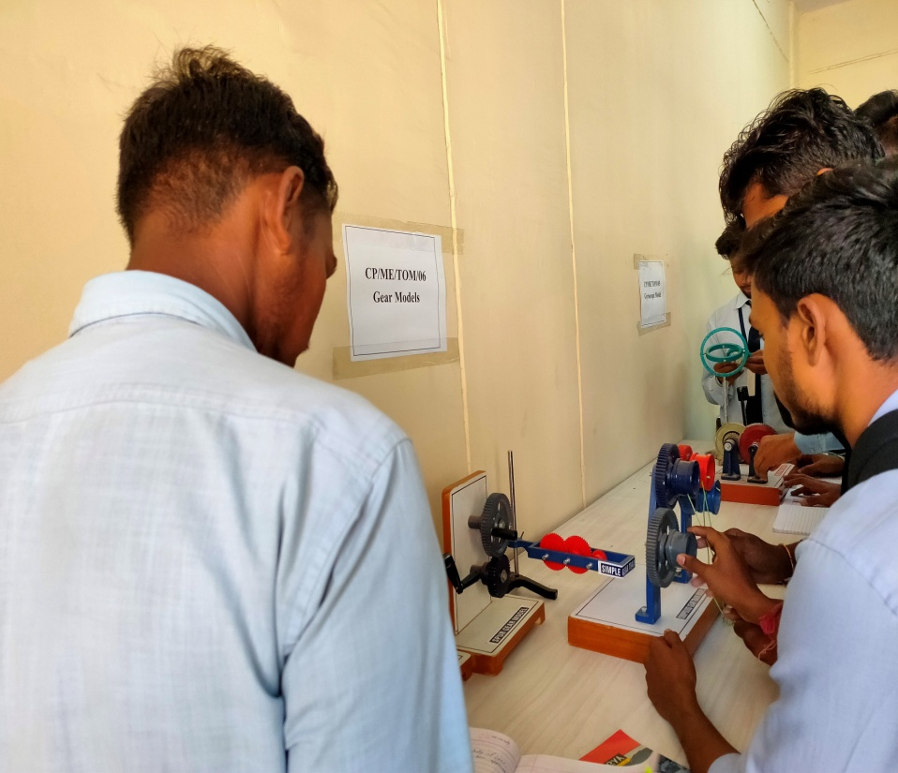
The Theory of Machines Lab

Slide 18
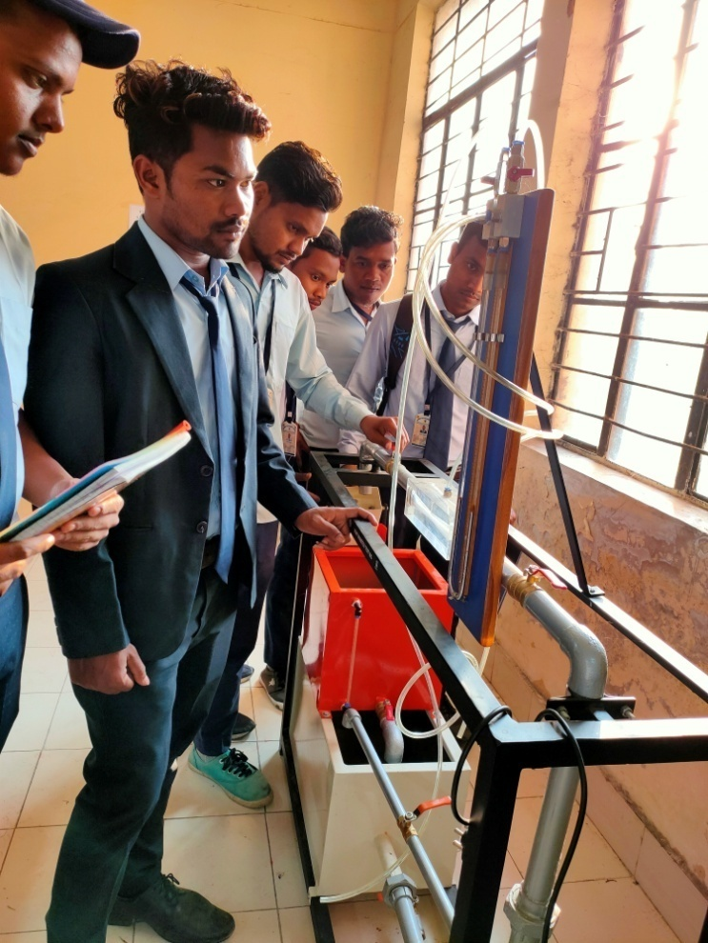
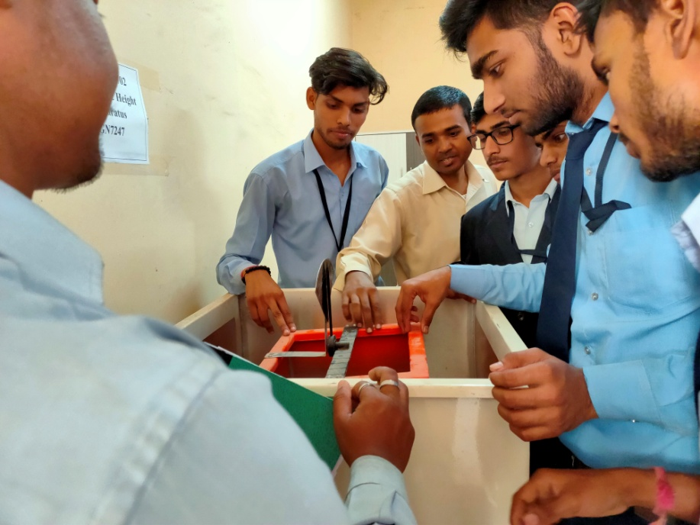
The Fluid Mechanics Lab

Slide 19
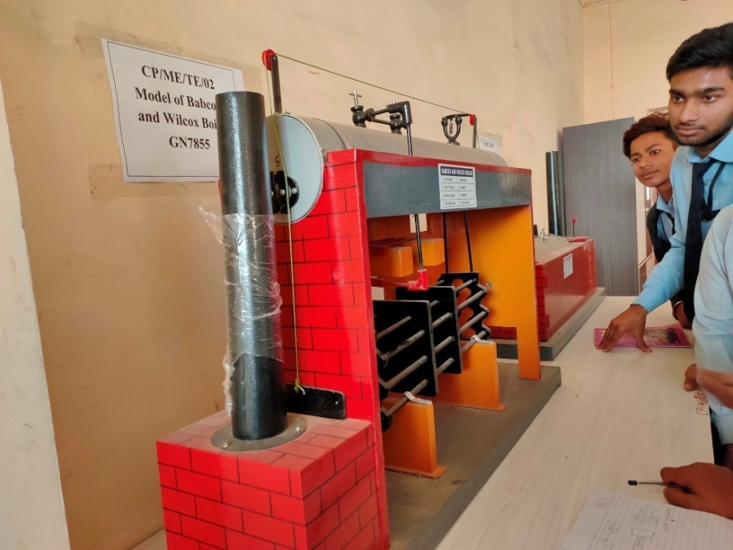
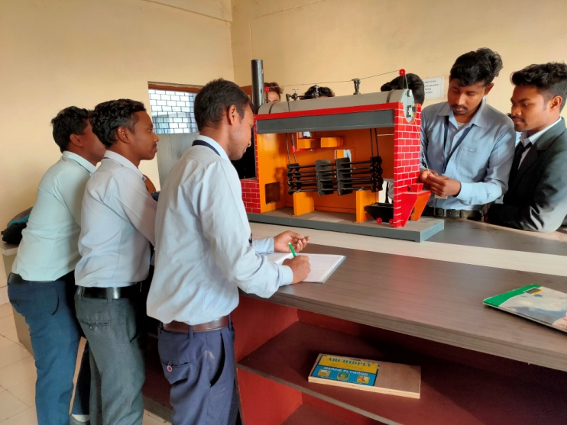
The Thermal Engg. Lab

Slide 20

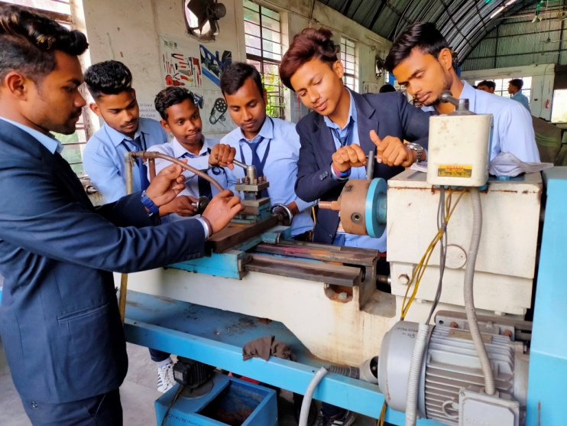
The Workshop

Slide 21
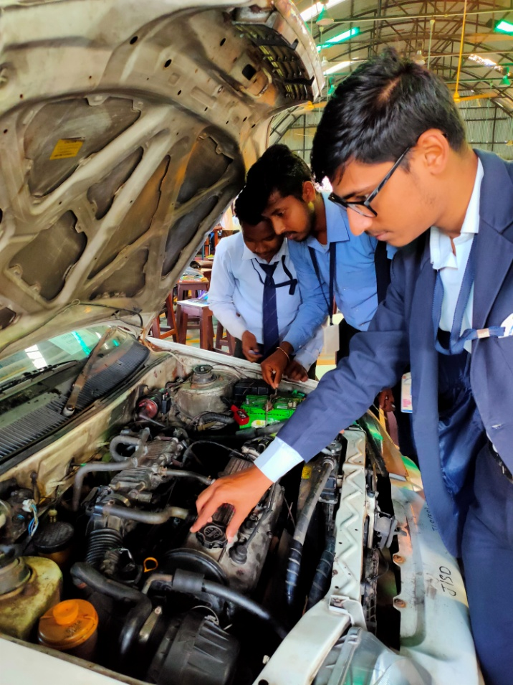
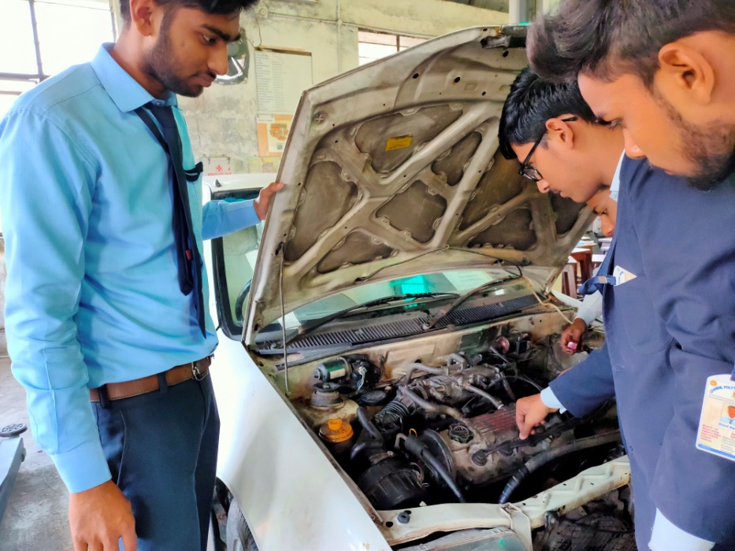
The Power Engg. Lab

Slide 22


Thank You!

